Slide 1


Fetal Alcohol Spectrum Disorders:
Competency II –
Screening and Brief Interventions for Alcohol Use
The Arctic FASD Regional Training Center is a project of the
UAA Center for Behavioral Health Research & Services.
Funding for this project is provided by CDC Cooperative Agreement #U84DD000886-01.
Notes:
This PowerPoint was created by the University of Alaska Anchorage Center for Behavioral Health Research & Services’ CDC-funded Arctic FASD Regional Training Center in 2010 and revised in 2013. The content is based primarily on materials and resources available in CDC’s Fetal Alcohol Spectrum Disorders Competency-Based Curriculum Development Guide for Medical and Allied Health Education and Practice (2009).
This guide was revised in 2015 and is available from www.frfasd.org/Comp_Guide.html.
If you are using elements of this PowerPoint in another presentation, please credit the Arctic FASD Regional Training Center and the 2009 Fetal Alcohol Spectrum Disorders Competency-Based Curriculum Development Guide for Medical and Allied Health Education and Practice.
Questions about this PowerPoint or its contents should be addressed to the Center for Behavioral Health Research & Services at the University of Alaska Anchorage – www.uaa.alaska.edu.
Funding was provided by the Centers for Disease Control and Prevention (CDC) to the Center for Behavioral Health Research and Services (CBHRS) at the University of Alaska Anchorage. The goal of the Arctic FASD Regional Training Center was to increase awareness about FASD among health and allied health students and professionals.
The CDC has identified seven core competencies that enable professionals to more effectively prevent, identify, and treat FASDs.
This presentation covers competency two, screening and brief interventions for alcohol use.

Slide 2

Road Map for Presentation
Who needs alcohol screening?
Risk factors for alcohol abuse
Alcohol screening methods
Drinking patterns
Brief interventions
Criteria for referral for treatment
Notes:
Road Map for Presentation
Today we’ll be discussing:
Who needs to be screened for their alcohol use.
Risk factors associated with alcohol abuse or misuse.
How to screen for alcohol use.
Brief interventions – what they are, how they work, how to use them.
Different types of drinking patterns and how they’re linked to alcohol misuse risk factors.
How and when to refer women to treatment programs.

Slide 3
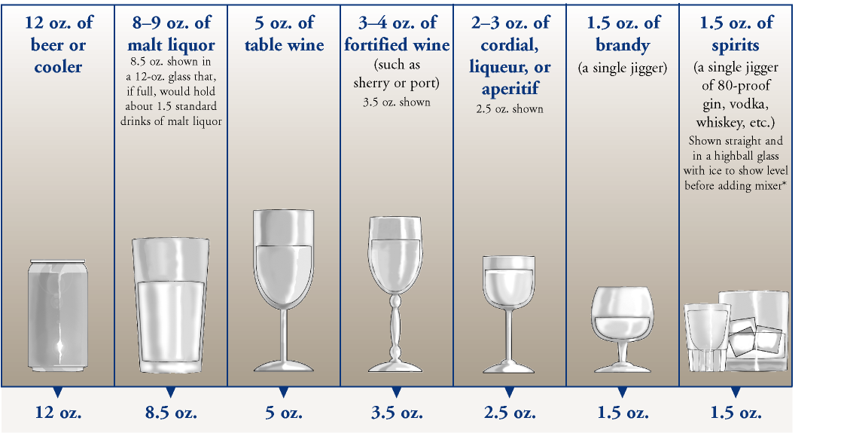
A Standard Drink
Notes:
Let’s start with a quick discussion about what a standard drink is.
To evaluate a rough equivalency of alcoholic beverages, it is important to consider the concentration of alcohol used in the beverage as well as the volume.
For example, NIAAA (National Institute on Alcohol Abuse and Alcoholism) guidelines (2005) use the following beverage types and volumes as rough equivalencies for standard drinks:
One 12-ounce (355 ml) can or bottle of beer
One 5-ounce glass of wine
One 12-ounce wine cooler
One 4-ounce glass of sherry, liqueur or aperitif
One 1.5 ounce ‘shot’ of liquor (distilled alcohol)
The quantity of alcohol in each of the drinks on this slide is approximately equal.
This is easily determined by estimating the percent alcohol used in the drink (e.g., beer = 3%–5% by volume).
Simple calculations indicate that one can of beer contains approximately 11 ml of alcohol (355 ml x 0.03), and within the 11 ml there is approximately 8.7 g of alcohol (11 ml x 0.789 g/ml).
Each of the drinks on this slide contains 8–10 grams of alcohol (roughly).
The exception is the “shot” of spirits.
While 1–1.5 ounces is commonly used in a “mixed drink,” the percent alcohol contained within the shot is variable with some spirits being 30% alcohol, and other spirits being 80% or more.
Although the high end of 10 grams of alcohol in one mixed drink would be a reasonable estimate, one must be aware that it could be greater depending on the spirits used in the drink.

Slide 4
Guidelines for Alcohol Use by Women
No more than one standard drink per day
No more that three standard drinks per occasion
Do not drink alcohol if…
  Pregnant
  Breastfeeding
  Planning pregnancy
  Sexually active and not using contraception
Notes:
Guidelines for Alcohol Use by Women
According to the NIAAA and the dietary guidelines from the U.S. Department of Health and Human Services, sensible alcohol limits for women include:
Not drinking more than one standard drink per day.
Not drinking more than three standard drinks per drinking occasion.
Not drinking alcohol at all if you are pregnant, breastfeeding, or planning to become pregnant soon.
Not drinking alcohol if you are sexually active and not using contraception.
Not drinking alcohol if you are driving, are taking certain medications, have a history of alcohol or drug dependence, or have certain medical conditions.
Presenters Note:
This is a good place for the standard drink demonstration.
Option One: Using a measuring cup, pour a dark colored juice or other non-alcoholic liquid into a standard wine glass or beer mug.
Option Two: Prior to the presentation, take a wine glass or other common alcoholic beverage container and pour different standard drink amounts into it. With a permanent marker, drawer a line at 1.5 oz, 4 oz, 5 oz, and 12 oz points.
These notes are from the FASD Competency-Based Curriculum Development Guide. For more information see Competency 1-pg. 2 and 3.

Slide 5

Binge drinking
Women: 4 or more drinks during any one occasion
Men: 5 or more drinks in any one occasion
An occasion is defined as 2-3 hours
Notes:
Since I’ve mentioned binge drinking several times now, I think it’s a good to make clear what is defined as a binge drinking episode.
Here we’re talking about standard drinks – a 12 oz bottle or can of beer, a 5 oz glass of wine, a 4 oz glass of fortified wine, or 1.5 oz or shot of hard liquor or spirits. This means that a 3 oz shot of vodka, rum, or tequila would be two standard drinks.
For women, this means 4 or more drinks per occasion, or 4 or more 12 oz bottles of beer, 4 or more 5 oz glasses of wine, etc.
For men, this means 5 or more drinks per occasion.
Keep these definitions in mind as we move through this workshop.
Additional data on Binge Drinking:
Binge drinking accounts for approximately half of all alcohol-related deaths (~40,000 between 2001-2005) and approximately 167.6 billion dollars in economic costs.
(2011) Behavioral Risk Factor Surveillance System (BRFSS) reported that on average, 18.4% of adults in the US and DC engage in binge drinking, the average number of binge drinking episodes is 4.1 times (in the past 30 days drinking) with approximately 7.7 drinks per episode.
Alaska has a prevalence of 17.9-20.4% adults engaging in binge drinking episodes in past 30 days and intensity of 7.1-7.8 drinks per episode.
Prevalence and intensity (amount drank) was highest in age groups 18-24 and 25-34; however individuals aged more than 65 years binge drank the most frequently. Non-hispanic whites had the highest prevalence (21.1%) and AI/AN had the highest intensity (8.4 drinks). Indivduals with a household income higher than $75,000 had the highest prevalence (22.2%), while those with incomes under $25,000 had the highest frequency (4.3) and intensity (7.1 drinks).

Slide 6
Why Screen for alcohol use?
Notes:
Why Screen for Alcohol Use?
Alcohol use by women during pregnancy has been associated with negative reproductive, infant, and child health outcomes.
Although the most widely recognized consequence of prenatal alcohol exposure is fetal alcohol syndrome (FAS), which occurs in an estimated 2 in 1,000 live births in the United States, the literature clearly indicates that FAS is not the only consequence of exposure.
Instead, it is suggested that the effects of exposure fall on a continuum now referred to as fetal alcohol spectrum disorders (FASDs), which are estimated to occur in 9 or 10 per 1,000 live births. FASDs can manifest in individuals in many different ways, most commonly as cognitive impairments and behavioral challenges. These effects are lifelong. For many individuals who experience an FASD there is no outward sign of their disability and many are misunderstood or misdiagnosed, often leading to a number of secondary disabilities.
Even low levels of alcohol consumption during pregnancy have been associated with negative developmental consequences. It is for this reason that the Surgeon General recommends that no alcohol be consumed if a woman is pregnant. However, as we will see, many women consume alcohol before they know they are pregnant. Early pregnancy is a critical time in the development of the fetus; exposure to alcohol at this point can have a negative outcome for the individual.
To prevent FASDs, it is important for health professionals to screen and counsel ALL women on their alcohol use.

Slide 7

Who Needs to Be Screened?
Women of childbearing age
Pregnant women
High-risk female drinkers
College-age women
Teens
Nursing mothers
Notes:
Populations Needing Screening– All women should be screened for alcohol use.

Slide 8
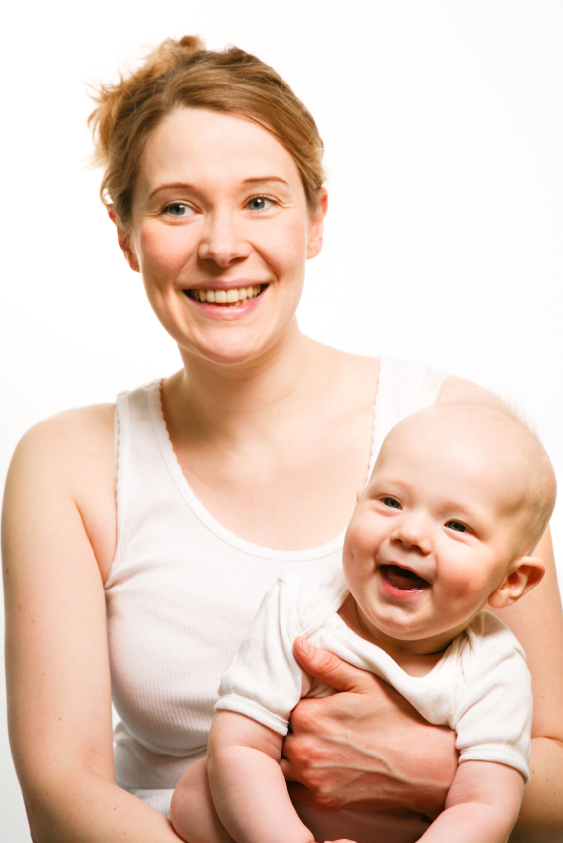
All Women of Childbearing Age
Women 18 to 44 years
Around 53% of women report some alcohol use
  12% report binge drinking
More than 50% who do not use birth control report alcohol use
  Approximately 13% are sexually active and drink alcohol frequently or binge drink
Notes:
Alcohol use among women of childbearing age (18 to 44 years) has remained high over the last decade.
Recent government surveys indicate that approximately 53% of women report some alcohol use.
Approximately 12% report binge drinking. (Here defined as five or more drinks per drinking occasion. More recently, the definition of binge drinking for women has been changed to four or more drinks on any one occasion.)
(2011, Behavioral Risk Factor Surveillance System (BRFSS) reports Binge Drinking in women to have self-reported prevalence of 12.2-12.8%, frequency (number of total binge episodes) of 3.1-3.3%, and intensity (average number of drinks during binge episode) of 5.6-5.8%.)
Results further indicate that more than 50% of women of childbearing age who do not use birth control (and therefore might become pregnant) report alcohol use.
Of those women not using effective birth control measures, approximately 13% are sexually active and drink alcohol frequently or binge drink, thereby putting them at high risk for an alcohol-exposed pregnancy.

Slide 9
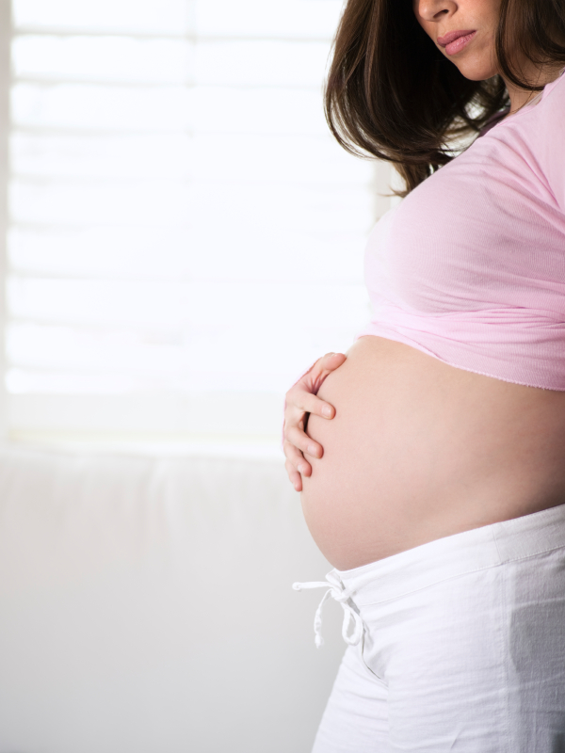
All Women of Childbearing Age
Pre-pregnancy drinking habits are predictive
  Women who drink prior to pregnancy may be more likely to drink during pregnancy
Many women continue to drink into the first trimester before knowing they are pregnant
Notes:
These high levels of general consumption and risk drinking among non-pregnant women of childbearing age are of concern.
Research has shown that prenatal drinking status is predictive of alcohol use during pregnancy.
Many women continue to drink well into the first trimester before they know they are pregnant, which is a particularly vulnerable time for the developing organ systems of the fetus.
Therefore, identifying women who are at high risk for an alcohol-exposed pregnancy and intervening with them before conception is an essential strategy for preventing alcohol-exposed pregnancies.

Slide 10
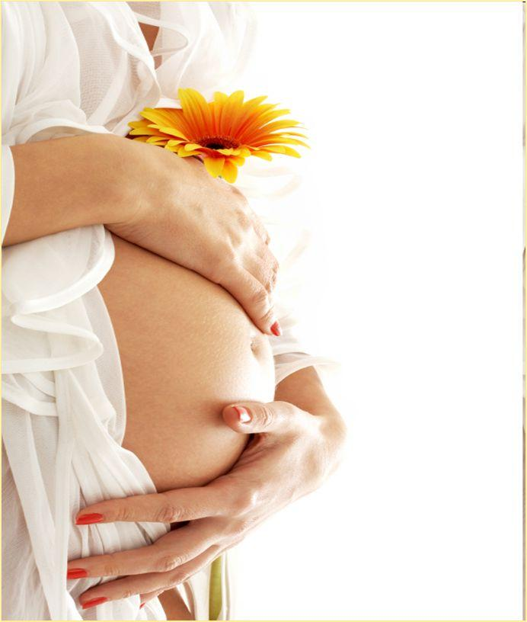
Pregnant Women
1 in 13 (or 7.6% of) pregnant women report alcohol consumption
1 in 71 (or 1.4%) report binge drinking
No real decrease over the last decade
Notes:
Pregnant Women (aged 18-44)
Most women reduce drinking when they find out they are pregnant; however, 10% of women report consuming alcohol at some point during their pregnancy. (Note that this may have been prior to discovering they were pregnant.) (Centers for Disease Control and Prevention. (1995). Sociodemographic and behavioral characteristics associated with alcohol consumption during pregnancy—United States, 1988. Morbidity and Mortality Weekly Report, 44(13),261–264.)
Two percent of pregnant women age 18-44 report frequent or binge drinking at some point during their pregnancy. (Tsai, J., & Floyd, R. L. (2004). Alcohol consumption among women who are pregnant or who might become pregnant—United States, 2002. Morbidity and Mortality Weekly Report, 53(50), 1178–1181; Substance Abuse and Mental Health Services Administration. (2002). Results from the 2001 National Household Survey on Drug Abuse: Volume I. Summary of National Findings. Rockville, MD: SAMHSA (Office of Applied Studies, NHSDA Series H-17, DHHS Publication No. SMA 02-3758)).
Among pregnant women, the highest estimates of reported alcohol use were among those who were:
Aged 35-44 years (14.3%);
White (8.3%);
College graduates (10.0%);
Employed (9.6%)
Research Example
In a sample of low-income minority pregnant women participating in the Special Supplemental Nutrition Program for Women, Infants, and Children (WIC), the rate of post-conception drinking was 24%, which is much higher than the estimated rate reported previously. (O’Connor, M. J., & Whaley, S. E. (2003). Alcohol use in pregnant low-income women in WIC. Journal of Studies on Alcohol, 64, 772–783.)
Significantly, of the women who reported post-conception drinking, about 62% reported drinking before they knew they were pregnant.
As pregnancy recognition in the sample did not occur until after about the 7th week of gestation, many women were drinking well into their first trimester placing their fetuses at significant risk.
Therefore, health professionals should be skilled in screening for alcohol use with women from varied cultural backgrounds both during pregnancy and prior to conception.

Slide 11
2012 BRFSS Study
‘Any alcohol use’ defined as having at least one drink of any alcoholic beverage in the past 30 days
Among pregnant women, highest prevalence estimates of reported alcohol use were among:
  Women aged 35-44 years (14.3%)
  College graduates (10.0%)
  Employed (9.6%)
  White (8.3%)
Notes:
Behavioral Risk Factor Surveillance System (BRFSS)
2006-2010 data
345,076 women, 18-44 years
13,880 pregnant women
331,196 non-pregnant women
Estimate prevalence of any alcohol use in past 30 days among women aged 18-44
Among non-pregnant women, 51.5% used alcohol
7.6% of pregnant women used alcohol
Binge drinking prevalence – 15% non-pregnant women, 1.4% pregnant women
If unmarried, more likely to report binge-drinking
MMWR 61(28):534-538 (July 20, 2012)
http://www.cdc.gov/mmwr/preview/mmwrhtml/mm6128a4.htm?s_cid=mm6128a4_e%0d%0a

Slide 12
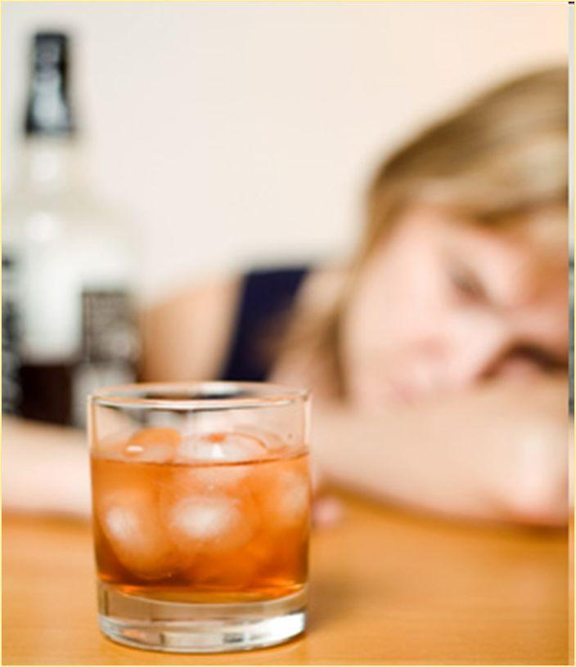
High-Risk Female Drinkers
Probability an alcohol-dependent woman will have a child with FASD
  25%-45%
Rate of FAS in children of women with a previous child with FASD
  771 per 1,000
Notes:
High-Risk Female Drinkers
The probability that an alcohol-dependent woman will have a child with fetal alcohol syndrome has been estimated to be 25%–45%. (Streissguth, A. P. (1997). Fetal alcohol syndrome: A guide for families and communities. Baltimore, MD: Paul H. Brooks Publishing Company.)
And along the spectrum of FASDs, it is not uncommon to see an increase in developmental disabilities with each successive pregnancy if the woman continues to drink.
The rate of FAS in the offspring of women who have already given birth to a child with FAS has been estimated to be 771 per 1,000, making these women extremely high risk. (Abel, E. L. (1988). Fetal alcohol syndrome in families. Neurotoxicology and Teratology, 10(1), 1–2.)
All women who have previously abused alcohol while pregnant or women who drink and have a child with an FASD should be screened for their alcohol consumption.

Slide 13
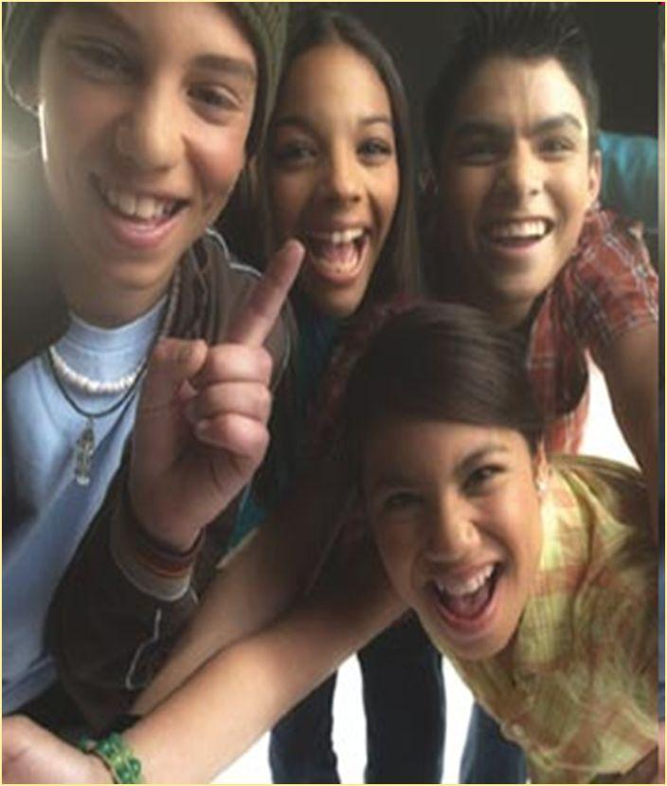
Teens
46% of high school girls report drinking alcohol
  28% report binge drinking
Many believe occasional heavy drinking during pregnancy is not harmful
Pregnant teens may be resistant to reducing their alcohol consumption
Notes:
Teens
Alcohol use among adolescents is a serious and growing problem.
46% percent of girls in 9th through 12th grade report drinking alcohol; 28% report binge drinking (described as five or more drinks) (Centers for Disease Control and Prevention. (2001). YRBSS: Youth Risk Behavior Surveillance System. Retrieved November 12, 2006, from http://www.cdc.gov/HealthyYouth/yrbs/index.htm.)
Although teen awareness of alcohol’s effects on the fetus is particularly important, studies of their beliefs and knowledge about the risks of drinking during pregnancy highlight that a substantial proportion of teens believe that occasional heavy drinking is not harmful, and suggest that teens perceive a safe level of drinking that is higher than the Surgeon General’s abstinence recommendations.
Thus, it is expected that pregnant teens whose peers use alcohol will be more resistant to reducing their alcohol consumption than will older pregnant women.
Research Example
In one study examining Black or African American, Hispanic, and White non-Hispanic pregnant adolescents, approximately 22% continued to drink during pregnancy (Rhodes, J. E., Gingiss, L., & Smith, P. B. (1994). Risk and protective factors for alcohol use among pregnant African-American, Hispanic, and White adolescents: The influence of peers, sexual partners, family members, and mentors. Addictive Behaviors, 19, 555–564.)
This percentage is higher than that reported by prevalence studies in the general U.S. population, but it is consistent with reports of drinking during pregnancy in older minority women.

Slide 14

College-Age Women
80% consume alcohol
  40% report binge drinking
Alcohol use negatively associated with contraceptive use
High-risk drinking may result in an unplanned pregnancy
Notes:
College-Aged Women
Many teens bring established drinking habits with them to college. In fact, several national surveys indicate that more than 80% of college students drink and that about half of those drinkers engage in heavy episodic consumption.
More than 40% of college students report recent binge drinking and high-risk drinking among female college students is increasing. (See references for studies.)
Research Example
Some studies have found that alcohol use might be associated with decreased contraceptive use among youth, putting college-age women at risk for unintended pregnancies.
One study reported that frequent binge drinkers were 7 to 20 times more likely than nondrinkers to engage in unplanned or unprotected sex, and an estimated 100,000 women per year had sex when they were so intoxicated that they were unable to consent. (Wechsler, H., Davenport, A., Dowdell, G., Moeykens, B., Castillo, S. (1994). Health and behavior consequences of binge drinking in college: A national survey of students in 140 campuses. Journal of American Medical Association, 272, 1672–1677; Hingson, R. W. (2002). Magnitude of alcohol-related mortality and morbidity among college students ages 18–24. Journal of Studies on Alcohol, 63, 136–144.)
Because high-risk drinking in college-age women can result in an unplanned pregnancy, health professionals who work with college women should be skilled in screening them for alcohol use.

Slide 15
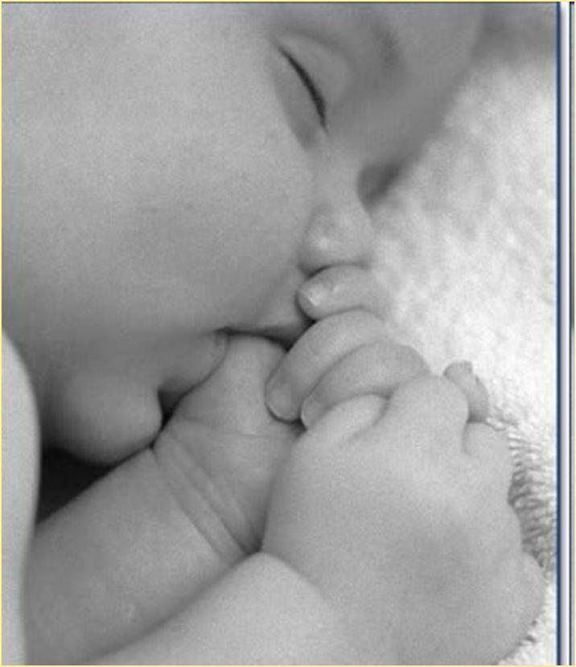
Nursing Mothers
Infants may consume less milk after mother consumes alcohol
Can alter infants sleep-wake pattern
Linked to delayed infant motor development
May affect future response to alcohol
Notes:
Nursing Mothers
Alcohol consumed by nursing mothers can be found in their breast milk. Studies suggest that infants consume less milk when their mothers consume an alcoholic beverage before nursing than when their mothers consume a nonalcoholic beverage. Acute exposure to alcohol in mothers’ milk has been shown to alter infants’ sleep-wake patterns resulting in a reduction in active sleep.
A positive association between maternal drinking and delayed infant motor development has also been demonstrated.
In addition to the effects of maternal alcohol consumption on infant nutrition and development, experience with the sensory qualities of alcohol in mother’s milk might affect the child’s responses to alcohol in the future.
For these reasons, it is important for health professionals to discuss alcohol consumption with nursing mothers.
Lindmark, B. (1990). Maternal use of alcohol and breast-fed infants. New England Journal of Medicine, 322, 338–339.
Mennella, J. (2001). Alcohol’s effect on lactation. Alcohol Research and Health, 25(3), 231–234.
Mennella, J., & Beauchamp, G. K. (1993). Beer, breast-feeding and folklore. Developmental Psychobiology, 26, 459–466.

Slide 16
Risk factors for alcohol misuse
Notes:
Transition…
Before transitioning into our discussion of risk factors for risky alcohol use, are there any comments or questions about who is in need of alcohol screening?
Risk factors
Considerable variation in developmental outcome occurs following prenatal alcohol exposure
The magnitude and timing of alcohol exposure are partially responsible for this variation in addition to a number of demographic and other risk factors.
When considering risk for alcohol use, the health professional must consider several demographic features of the women with whom they work.
These include ethnicity, level of acculturation, socioeconomic status (SES), maternal age, age at first drink, number of children, and marital status.
Although these risk factors are important to consider when thinking about possible alcohol use by women, they should not be used to establish a profile of a typical drinker or to eliminate possible women from universal screening.
Nevertheless, health care professional should be aware of these risk factors when working with women of childbearing age… REPEAT AFTER THIS SECTION…
Presenters note:
This is a good place for a discussion about how every woman of childbearing age is at risk for an alcohol exposed pregnancy if they are consuming alcohol and having unprotected sex.

Slide 17
Ethnicity and Acculturation
Culture
  Socially transmitted patterns of behavior, values, beliefs, etc.
Acculturation
  Changes in the culture of a group or individual as a result of contact with a different culture
Ethnic differences in drinking patterns
  Environmental, historical, cultural, genetic
Increased acculturation is associated with increased alcohol consumption within an ethnic group
Notes:
Ethnicity and Acculturation
Ethnicity and level of acculturation have been identified as risk factors for alcohol misuse. In order to understand this link, first let’s define culture and acculturation.
A simple definition of culture is the socially transmitted patterns of behavior, knowledge, values, beliefs, art, and customs of a group. Acculturation is the process of adopting the cultural traits or social patterns of another group, or the results of this process. All peoples can become acculturated. Acculturation can follow as the changes in the culture of a group or individual as a result of contact with a different culture.
Drinking patterns appear to differ among women from different ethnic backgrounds and are influenced by genetic, environmental, historical, and cultural factors. Similar findings have been reported in studies concentrating on changes in drinking patterns over time in different ethnic minority populations, with special emphasis on women.
Analysis of data from a large national study found 25% of White, non-Hispanic women reported drinking during pregnancy compared with 12% of Black, non-Hispanic women and 11% of Hispanic women.
However, in a study comparing changes in drinking patterns in a sample of non-pregnant women from 1984 to 1995, the mean rate of consumption for White, non-Hispanic women who were frequent heavy drinkers decreased, whereas the mean for Black and Hispanic women remained the same or increased slightly.
In another study, an increase in alcohol consumption by Hispanic women was observed with each successive generation following immigration to the US. Higher rates of alcohol use was reported among those who were younger, more educated, employed, and unmarried. There was also a higher rate among English-speaking women (similar to their White or Black non-Hispanic English-speaking peers) compared to Spanish-speaking women.
Acculturation appears to interact with other socio-demographic factors in shaping the drinking practices of minority women. (That is, there are a lot of factors that influence a woman’s drinking pattern.)
See page 5 of competency II for more specific information regarding ethnicity. This will be necessary for more in-depth trainings on screening techniques. See the references handout for studies on this subject.
Presenter note: Make sure to note that acculturation does not just apply to indigenous or minority culture. Providing an example of acculturation outside of ethnicity is a nice way to expand thinking on this topic.
Examples:
Freshmen at college adopt the social patterns of college life.
Graduate students adopt the social patterns and customs of graduate school.
Those newly arrived in Alaska adopt the social patterns and customs of Alaska.
Americans moving to other countries adopt the social patterns, customs, foods of that country.
(There are a variety of dynamics that can affect whether a group experiences acculturation. According to O’Neil, it “often depends on the relationship between the culture that is receiving the new traits and the culture of their origin.” For example, if a culture that is stronger militarily feels that its culture is inferior, it may adopt the culture of the people they have encountered. Examples: The Germanic tribes after conquering the Roman Empire; the Mongols after they conquered China. http://anthro.palomar.edu/change/change_3.htm)

Slide 18
Risk Factors
Maternal age
Age of first drink
Number of children
Previous child with FAS
Marital status
Socioeconomic status
Notes:
Maternal age
Maternal age has been shown to be an important moderator of vulnerability to FAS and other alcohol-related deficits, including physical growth, mental development, and information processing speed, with the children of mothers older than 30 years of age showing the most dramatic negative effects.
Age of first drink
Data from a national survey of 43,000 adults in the United States suggest that those who began drinking before age 14 are at greater risk of developing alcohol dependence.
Number of children and having a previous child with FAS
Studies suggest that the risk for FAS increases with each successive pregnancy; the rate increases to 771 in 1,000 live births for the younger sibling of a child with FAS.
Marital status
Regardless of age, ethnicity, or economic status, women who are separated, divorced, or never married are at greater risk for having a child with FAS or alcohol-related birth defects. Also more likely to engage in binge-drinking patterns
Socioeconomic status
A significant demographic risk factor associated with the drinking behavior of women during pregnancy appears to be socioeconomic status.
Despite the fact that drinking prevalence rates are highest among White, non-Hispanic women, as compared with their Black, non-Hispanic and Hispanic counterparts, lower socioeconomic status has been postulated to increase the risk of FAS.
For example, a study found the incidence of FAS was nearly 10 times higher in a sample of low-income minority women compared to a sample of White middle and upper class women.
Differences were much lower in standardized samples from large multi-site surveillance studies by the CDC, but rates of FAS are consistently higher among women of ethnic minority status, even though these groups of women tend to drink less than their White counterparts.

Slide 19
Risk Factors
Genetics: How the body metabolizes ethanol
Depression
Heavy alcohol use in family
High-risk drinking
Other substance use and treatment episodes
Beliefs about alcohol
Notes:
Genetic predisposition
Both animal and human studies have shown support for pharmacogenetic differences dictated by genetic variations in ethanol metabolism as determinants of susceptibility to alcohol-related effects. This means: Both animal and human studies have shown evidence that there are genetic variations in the metabolism of ethanol. This may affect how susceptible a particular individual is to experiencing the effects of alcohol or prenatal alcohol exposure.
Pharmacogenetic = genetic differences that may lead to differences in the metabolism of drugs; this may in turn lead to differences in individual responses to drugs (therapeutic and/or adverse)
Depression
An extended analysis of 15 national surveys found that depression contributes to increased drinking levels among women. In reviews of the literature on women and alcohol use, depression is consistently documented as part of a complex etiology of drinking problems.
Etiology: the study of causes of diseases; the cause or origin of a disease
Heavy use in family
Women in households in which other family members, especially their spouse, have alcohol problems are more likely to continue to drink during pregnancy.
High-risk drinking
Heavy episodic drinking has been identified as an important risk factor because of the demonstrated association between binge drinking and unintended pregnancy.
Other substance use
Results of a recent study of 2,672 English-speaking women aged 18 to 44 from six different outpatient treatment settings and an urban jail revealed that recent drug use, history of smoking more than 100 cigarettes, and history of inpatient treatment for drugs, alcohol, or mental health treatment correlated significantly with risk for an alcohol-exposed pregnancy. Having multiple sex partners and recent physical abuse were also related to risk.
Beliefs about alcohol
Alcohol expectancies—positive or negative beliefs about the consequences of using alcohol—constitute a powerful construct for examining cognitions about alcohol because they might play a causal role in the initiation and maintenance of alcohol use.
Transition to screening techniques…
In a recent study conducted at UCLA on low-income minority women, after numerous demographic measures were considered, the best predictor of alcohol use was the woman’s score on a screening measure of high-risk drinking.
THESE ARE NOT INTENDED TO PRESENT A PROFILE OF AN AT-RISK WOMAN…

Slide 20
Screening methods

Slide 21
Considerations for Screening
Issues of validity and reliability
Brevity of the screening tool
Multiple measures
  Factors to improve reporting:
    Alcohol free
    Confidentiality
    Clinical setting
    Clear wording of questions
Notes:
We are going to shift gears now and look at screening methods and tools for discussing alcohol use with women. First, I want to bring up a few considerations for screening.
Primary care physicians need to ask ALL women about their alcohol use.
One of the main challenges to identifying a group of at-risk alcohol users is how to effectively screen for alcohol use and related problems using reliable methods.
Despite substantial literature on the validity and reliability of self-report of alcohol use and abuse, the issue of underreporting of drinking levels must always be considered.
Factors shown to increase accurate and truthful reporting include:
Being certain the individual is alcohol free when interviewed
Ensuring confidentiality
Conducting the interview in a clinical setting
Wording questions and questionnaires clearly
Furthermore, using more than one alcohol consumption measure can enhance the validity of self-report. When screening women in busy clinic settings, it is important the instrument is easy to administer and brief.
Each instrument has strengths and weaknesses and varies in its applicability to clinical settings.
When selecting a screening tool for routine implementation, health care professionals should consider factors such as:
Goals of the screening process
Features of the target population (age, pregnancy, ethnicity, literacy rates, etc.)
Ease of administration

Slide 22
Screening Methods
Quantity-frequency (QF)
  Amount of drinking of average drinking occasion
  Average # of days alcohol consumed
  Type of alcohol consumed
Screening tools
  T-Ace and TWEAK
  Audit-C
  Timeline Follow Back
  Trauma Questionnaire
  CRAFFT
Notes:
The physicians’ guide developed by NIAAA recommends quantity/frequency and binge-drinking questions as the primary screening test.
Quantity-frequency measures (QF) inquire about average or typical consumption patterns. The simplest measures assess amount of drinking on average drinking days (Q), and the average number of days on which alcohol is consumed (F).
An additional feature that should be included in any QF assessment is the measurement of the types of alcoholic beverages most often consumed.
It is generally assumed in alcohol-related research that all drinks are equivalent in terms of the amount of absolute alcohol. That is, a standard drink is defined as 0.60 ounces of pure alcohol, which is equivalent to one 12-ounce beer or wine cooler, one 5-ounce glass of wine, or 1.50 ounces of 80-proof distilled spirits.
On the second half of this slide, various screening tools are listed, each of which utilize elements of Q and F. We will go thorough these in the coming slides.

Slide 23
Screening Tools
T-ACE
Tolerance, Annoyed, Cut down, Eye opener
TWEAK
Tolerance, Worry, Eye opener, Amnesia, Cut down
AUDIT-C
Questions about alcohol consumption over last 12 months
Frequency, amount, binge drinking episodes
Notes:
Several questionnaires have been developed to screen for problematic alcohol use and evaluated in multiple settings. In general a positive screen does not indicate a diagnosis of alcoholism, but rather a need to discuss the risk of drinking during pregnancy.
The two most commonly used screening tools with pregnant women are the T-ACE and the TWEAK.
The T-ACE has four questions that take less than a minute to ask. The questions relate to:
TOLERANCE. How many drinks does it take to make you feel high?;
Have people ANNOYED you by criticizing your drinking?
Have you ever felt you ought to CUT DOWN on your drinking?
EYE OPENER. Have you ever had a drink first thing in the morning to steady your nerves or get rid of a hangover?
One point is given for each affirmative answer to questions A, C, and E, 2 points if the woman responds that it takes three or more drinks to feel high (Tolerance). A positive screen is a score of 2 or more points.
The TWEAK attempts to elicit the following:
TOLERANCE for alcohol
WORRY or concern by family or friends about drinking behavior
EYE OPENER, the need to have a drink in the morning
“Blackouts” or AMNESIA while drinking;
The self-perception of the need to CUT DOWN on alcohol use.
The AUDIT-C is another short questionnaire developed to screen for problematic alcohol use.
The three questions on the AUDIT-C screen are:
During the last 12 months, about how often did you drink ANY alcoholic beverage?
Counting all types of alcohol combined, how many drinks did you USUALLY have on days when you drank during the last 12 months?
During the last 12 months, about how often did you drink FIVE OR MORE drinks in a single day?
Presenter note: This is a good place to insert a role play activity to actively involve participants in the learning. There are hand outs of these tools in the CDC handbook to reproduce and use.

Slide 24
Screening Tools
Timeline Follow Back
Recent alcohol use – pattern and level of consumption
Trauma Questionnaire
Four questions about injuries in the last 5 years
UCLA Alcohol Screener
Quantity, frequency, TWEAK
Notes:
Timeline Follow Back
Intensive interview method for assessing recent drinking behavior developed primarily for alcohol use research
Detail picture of a person’s drinking over a designated time period
Can be administered by an interviewer, self-administered, or by a computer
Retrospectively estimate daily alcohol consumption
Takes 10 to 30 minutes to complete
Available in English, Spanish, French, no cost but is copyrighted
Evaluated with clinical and non-clinical drinker populations
Yields data on pattern, variability, and level of drinking
Because it is a detailed and intensive screening method, it may not be useful for a busy clinic setting
Trauma Questionnaire
Studies have shown a strong association between alcohol intoxication and trauma
Trauma questionnaire is designed to be an unobtrusive way to screen for alcohol use; it doesn’t ask them directly about their alcohol use
Four questions about injuries they have had in the last 5 years: fractures, dislocations, traffic accidents, head injury, injuries sustained as a result of a fight or assault
High sensitivity and specificity for identifying high-risk alcohol use and acceptable to respondents and physicians
UCLA Alcohol Screener
Used the screening methods previously mentioned
Screen pregnant drinkers in a California sample of low-income, minority women participating in WIC
Self-report
Asked how much they drank on an average day and the average number of days on which alcohol was consumed
Asked for two periods: after conception but before the women knew they were pregnant; and after pregnancy recognition
Included TWEAK
All women who screened positive for alcohol use were given a brief intervention
Not yet validated against other screening measures, but may be useful for busy clinics while women are waiting to see a healthcare provider

Slide 25
Screening Tools
CRAFFT
Car, Relax, Alone, Forget, Friends, Trouble
For use with adolescents and college-aged youth
Notes:
CRAFFT
The use of screening tools developed for adults is not recommended for screening adolescents and college-age youths. One brief screening device, the CRAFFT, was developed for adolescents.
It is simple to score, asks about alcohol and drug use, and has good psychometric properties in a sample of predominately female youths between the ages of 14 and 18.
CRAFFT asks the following six questions:
C Have you ever ridden in a CAR driven by someone (including yourself) who was high or had been using alcohol or drugs?
R Do you ever use alcohol or drugs to RELAX, feel better about yourself, or fit in?
A Do you ever use alcohol or drugs while you are by yourself, ALONE?
F Do you ever FORGET things you did while using alcohol or drugs?
F Do your family or FRIENDS ever tell you that you should cut down on your drinking or drug use?
T Have you ever gotten into TROUBLE while you were using alcohol or drugs?

Slide 26
Screening Tool Administration
Method of delivery influences truthfulness of reporting
Self-report
  May improve validity
Face-to-face
  May not be comfortable for women
  May underestimate alcohol use
Computer-assisted
  Increased privacy
  Audio-recorded questions
  Ease of use for those with poor literacy & computer skills
Notes:
Administration of screening tools
The method of delivery of questions about alcohol use has been shown to influence truthful reporting. Self-administered questionnaires might improve the validity of self-report.
The Audio Computer-Assisted Self-Interviewing (ACASI) technology has been used successfully in prenatal clinics serving disadvantaged, low-literate, minority women. Patients can answer questions by pressing a few keys on the computer.
Advantages include ease of use for respondents with poor literacy or computer skills, as well as increased privacy.

Slide 27
Brief Intervention
Short, one-on-one counseling sessions
Can be easily incorporated into busy practices
Suitable for those whose drinking patterns may be harmful, but who are not alcohol-dependent
Goal is to moderate a person’s alcohol consumption, to eliminate or decrease harmful drinking practices
Notes:
NIAAA, Alcohol Alert, No. 66, 2005
Short, one-on-one sessions
Suited for those who drink in ways that are harmful or abusive, but who are not necessarily dependent
Can be given in a matter of minutes
Minimal follow-up
Goal is to moderate a person’s alcohol consumption, eliminate or decrease harmful drinking practices
May benefit from additional education, encouragement
http://pubs.niaaa.nih.gov/publications/aa66/aa66.htm

Slide 28
Brief Intervention
Key ingredients of standardized BI
  FRAMES
    Feedback of personal risk
    Responsibility for personal control
    Advice to change
    Menu of ways to reduce or stop drinking
    Empathetic counseling style
    Self-efficacy about reducing or stopping drinking
Use a supportive and non-judgmental style
Notes:
Brief intervention (BI) has been shown to be an effective, low-cost treatment alternative for alcohol problems that uses time-limited, self-help, and preventative strategies to promote reductions in alcohol use in nondependent individuals, and in the case of dependent persons, to facilitate their referral to specialized treatment programs.
BI for alcohol problems has been shown to be more effective than no intervention and often is seen as effective as more extensive intervention.
BI is usually restricted to fewer than four sessions and is typically performed in a treatment setting that is not specific for alcoholism. It is often performed by personnel who are not specialized in the treatment of alcohol use and abuse. It is provided to individuals at varying risk for negative consequences caused by drinking, rather than those considered to be alcohol dependent.
Six elements characterize the key ingredients of standardized brief intervention, summarized by the acronym FRAMES. These include:
Feedback of personal risk.
Responsibility for personal control.
Advice to change.
Menu of ways to reduce or stop drinking.
Empathetic counseling style.
Self-efficacy or optimism about cutting down or stopping drinking.
The intervention also involves establishing a drinking goal in the form of a signed contract and follow-up of progress with ongoing support.
Studies reveal that supportive, nonjudgmental techniques in which trained personnel counsel women lead to decreased alcohol consumption during pregnancy.
The most effective intervention approaches avoid the use of moral or volitional injunctions and instead focus on reduction of alcohol use without criticism or provocation of guilt.

Slide 29
Brief Interventions
Motivational interviewing
  Empathetic, patient-centered approach
  Works with ambivalence about behavior change to increase readiness for change
  Goal is to enhance discrepancy between reasons to change vs. stay the same
Notes:
Motivational Interviewing
Motivational interviewing (MI), one form of BI, is an empathic, patient-centered counseling approach for increasing readiness for change by resolving ambivalence about behavior change.
The process involves exploring the client’s ambivalence to making behavioral changes in an atmosphere of acceptance, warmth, and positive regard.
Although the session is directive, direct persuasion and coercion are avoided.
Goal of MI
The goal is to enhance the discrepancy between the reasons for changing versus the reasons for staying the same.
More than 24 studies of motivational interviewing have yielded beneficial effects in decreasing problem drinking and other health-related problem behaviors.
Research example:
CHOICES (Changing High-risk alcohol use and Increasing Contraception Effectiveness Study) is an example of a selective intervention using motivational interviewing aimed at preventing alcohol-exposed pregnancies among high-risk women in special community settings.
This project focused on providing women two alternatives: reducing risk drinking levels or instituting effective contraception.
Participants were non-pregnant women who were of childbearing age, fertile, sexually active, and using ineffective or no contraception at study commencement.
The intervention consisted of four sessions using motivational interviewing and one contraceptive counseling session aimed at moving the women to change one or both of the target behaviors.

Slide 30
Brief Interventions
Manualized brief interventions
  Helpful in high-paced settings
  Effective
Computerized brief intervention
  “Video-doctor technology”
  Not tested with pregnant women yet
Notes:
Manualized brief interventions
The usefulness of MI in a busy clinic or medical practice might be limited because it requires considerable training and clinical skill.
Standardized, manualized BI techniques to reduce alcohol consumption have been developed.
Results of several studies provide evidence of the efficacy of standardized brief intervention strategies with pregnant women for promoting reductions in alcohol consumption.
Computerized brief intervention
A potential tool for administering an intervention is “video doctor technology” in which health questions are asked using an interactive computer program.
Pilot results of this approach indicate that individuals respond positively to a computerized presentation, and it is easily used even by those with little computer experience.
However, this approach has yet to be tested on pregnant women.

Slide 31
Brief Interventions
Improving clinicians’ use of brief intervention
  Educational programs
  Step-by-step, evidence based protocols
  Skills-based role playing
  Peer group discussions
Conclusions regarding brief intervention
  Administered by health care professionals
  Effective at reducing prenatal alcohol consumption
Notes:
Improving clinicians’ use of brief intervention
Research devoted to finding ways to encourage wider use of brief interventions by clinicians indicates that current routine educational approaches might not be effective
Strategies found to be effective included (a) conducting educational programs at the intervention site; (b) using specific step-by-step, evidence-based clinical protocols; (c) using skills-based role playing; (d) holding peer group discussions; and (e) using a credible expert trainer or educator.
Brevity, repetition, and reinforcement of recommended practices are also key program elements.
Conclusions regarding brief intervention
Brief interventions administered by physicians and allied health professionals in medical and non-medical settings are effective in bringing about reductions in drinking in the preconception and pregnancy periods.
Women who are pregnant, planning a pregnancy, or at risk for pregnancy, should be advised not to drink, as damage to the fetus can occur before they know they are pregnant, and no safe threshold of alcohol use during pregnancy has been established.
Women who are fertile, sexually active, and not using effective contraception should be advised that they are at risk for an alcohol-exposed pregnancy and should abstain from alcohol use or establish effective contraception.
Women of childbearing age who are using effective contraception should be advised to drink no more than seven standard drinks per week and no more than three standard drinks on any one occasion.

Slide 32
Extensive Interviews
Health Interview for Women
  Asks pregnant women to estimate her alcohol use
    Before pregnancy and current use
    Yields standard alcohol measures
    Asks about other substance use
NIAAA Health Screening Survey
  Two sets of questionnaires
    Women of childbearing age
    Pregnant women
  General health questions, drinking over last 3 months, T & W questions from TWEAK
Notes:
Health Interview for Women
The Health Interview for Women is an adaptation of an interview developed by Day and Robles that requires the pregnant woman to estimate the extent of her current alcohol use.
This interview was used in the UCLA WIC study to decrease drinking levels in low-income, pregnant, minority women.
It inquires about the woman’s drinking before she recognized she was pregnant and about current use—now that the woman knows that she is pregnant.
The Health Interview yields standard alcohol measures of average number of drinks per drinking occasion, maximum drinks per occasion, and the frequency of both.
The brand of alcohol the woman uses and the estimated number of ounces consumed is included.
Questions about smoking, caffeine intake, and prescription and illegal drug use, are also included on the interview.
NIAAA Health Screening Survey
The NIAAA health screening survey is composed of two sets of questionnaires, one for women of childbearing age who are NOT pregnant, and one for women who ARE pregnant.
Using a decision tree format, the screener starts with general health-related questions, then asks about drinking in the last 3 months and includes the T and W questions from the TWEAK.
If a woman screens positively on any of the alcohol related questions, she is then asked nine questions about negative consequences associated with her drinking.
Based on her responses, she is classified as an at-risk drinker, problem drinker, or possibly alcohol-dependent.
The questionnaire for pregnant women uses the same questions as those for non-pregnant women, but the respondent is asked about drinking 3 months prior to pregnancy and currently, during pregnancy.
The tolerance for classifying risk is lower for pregnant women than for non-pregnant women.

Slide 33
Categories of Alcohol Use
Abstainers
Low-risk drinkers
At-risk drinkers
Problem drinkers
Alcohol dependent drinkers
Notes:
This slide presents categories of alcohol use in women. This is what are trying to determine during our screening, and these categorizations help guide our interventions and referrals.
Abstainers
Do consume no alcohol at all or less than 1 standard drink per month.
Low-risk drinkers
Consume 1–2 standard drinks per day, three or fewer times per week.
Their use of alcohol does not affect their health and it does not result in negative consequences.
They do not use alcohol before driving, when pregnant, when breastfeeding, or with certain medications.
At-risk drinkers
Consume 7–21 standard drink per week; consume more than 3–4 standard drinks per occasion, or drink in high-risk situations.
Problem drinkers
Consume more than 21 standard drinks per week and might experience negative consequences from such drinking (behavioral, family, medical, mental health, employment, social, legal, etc.).
Alcohol-dependent drinkers
Cannot stop drinking once they start.
They experience repeated negative consequences from such drinking (behavioral, family, medical, mental health, employment, social, legal, etc.).
Heavy drinking leads to a physical need for alcohol.

Slide 34
Criteria for Referral to Treatment
At-risk drinkers
  Brief intervention
Problem drinkers
  Brief intervention
Possible alcohol-dependent drinkers
  Brief intervention
  Refer for specialized treatment
Notes:
Women who are not pregnant
Patient is an at-risk drinker.
One positive response on the Health Screening Survey and negative responses to the nine assessment questions having to do with consequences of drinking (behavioral, family, medical, mental health, employment, social, legal)
Patient is a problem drinker.
Positive responses on the Health Screening Survey and one or two positive responses on the assessment questions.
Patient might be alcohol-dependent.
Positive responses on the Health Screening Survey and three or more positive responses on the assessment questions.
Women who are at-risk or problem drinkers should receive brief intervention.
Women who might be alcohol-dependent should receive brief intervention and be referred to specialized treatment.
Women who are pregnant
Patient is an at-risk drinker.
One positive response on the Health Screening Survey and negative responses to the nine assessment questions having to do with consequences of drinking (behavioral, family, medical, mental health, employment, social, legal).
Patient is a problem drinker.
Positive responses on the Health Screening Survey and one or two positive responses on the assessment questions.
Patient might be alcohol-dependent.
Positive responses on the Health Screening Survey and three or more positive responses on the assessment questions.
Pregnant women who are at-risk or problem drinkers should receive brief intervention. Those who might be alcohol-dependent should receive brief intervention and be referred to specialized treatment.

Slide 35
In Closing….
Who needs alcohol screening?
Risk factors for alcohol abuse
Alcohol screening methods
Brief interventions
Drinking patterns
Criteria for referral
Notes:
Review material covered…

Slide 36


Arctic FASD Regional Training Center www.uaa.alaska.edu/arcticfasdrtc arcticfasdrtc@uaa.alaska.edu
907.786.6381
The Arctic FASD Regional Training Center is a project of the UAA Center for Behavioral Health Research & Services.
Funding for this project is provided by CDC Cooperative Agreement #U84DD000886-01.

