Slide 1


Fetal Alcohol Spectrum Disorders:
Competency I - Foundation
The Arctic FASD Regional Training Center is a project of the
UAA Center for Behavioral Health Research & Services.
Funding for this project is provided by CDC Cooperative Agreement #U84DD000886-01.
Notes:
This PowerPoint was created by the University of Alaska Anchorage Center for Behavioral Health Research & Services’ CDC-funded Arctic FASD Regional Training Center in 2010 and revised in 2013. The content is based primarily on materials and resources available in CDC’s Fetal Alcohol Spectrum Disorders Competency-Based Curriculum Development Guide for Medical and Allied Health Education and Practice (2009).
This guide was revised in 2015 and is available from www.frfasd.org/Comp_Guide.html.
If you are using elements of this PowerPoint in another presentation, please credit the Arctic FASD Regional Training Center and the 2009 Fetal Alcohol Spectrum Disorders Competency-Based Curriculum Development Guide for Medical and Allied Health Education and Practice.
Questions about this PowerPoint or its contents should be addressed to the Center for Behavioral Health Research & Services at the University of Alaska Anchorage – www.uaa.alaska.edu.
Funding was provided by the Centers for Disease Control and Prevention (CDC) to the Center for Behavioral Health Research and Services (CBHRS) at the University of Alaska Anchorage. The goal of the Arctic FASD Regional Training Center was to increase awareness about FASD among health and allied health students and professionals.
The CDC has identified seven core competencies that enable professionals to more effectively prevent, identify, and treat FASDs.
This presentation covers competency one, foundation.

Slide 2

Road Map for Presentation
Biomedical foundation of FASDs
Characteristics of FASDs
Clinical issues
Prevalence and demographics of FASDs
Psychological, social, and cultural aspects of FASDs
Notes:
We will begin with the basic biomedical foundations of FASDs
We will cover the broad scope of the issue
The historical recognition of the issues
The effects of alcohol on the developing embryo and fetus
And the characteristics of FAS
We will then move on to some clinical issues related to FASDs
Specifically, we will discuss prevention of alcohol-exposed pregnancies
Screening and diagnosis of persons with FAS and treatment and therapy options for FASDs
Finally, we will address epidemiological and psycho-social-cultural aspects of FASDs
Specifically, we will talk about the prevalence of FASDs
Monitoring prenatal alcohol exposure
And the psychosocial and cultural effects.
By the end of today’s presentation, you should be able to…
Describe the basic biomedical foundation of FAS
Explain the basic clinical issues related to FASDs
And provide an overview of the epidemiological and psycho-social-cultural aspects of FASDs.

Slide 3
Biomedical Foundation of FASD

Slide 4
Alcohol Use in the U.S.
Long history of alcohol use
  Widely entrenched in U.S. society
Gender
  Women’s alcohol consumption has gradually increased
Pregnancy
  Alcohol use may decrease the likelihood of effective contraceptive use
  Most women decrease their use or stop consuming alcohol when they discover they are pregnant
Notes:
Alcohol use in the U.S.
Alcohol use is entrenched in the United States. In addition, worldwide use and subsequent abuse of alcohol is increasing.
In the U.S., as many as 74% of individuals over 15 consume alcohol. The amount of alcohol consumed by each person is increasing; among people who report binge drinking, the number of binge drinking episodes has increased.
Define binge drinking: For men, an episode of binge drinking is defined as 5 or more drinks per any one occasion. For women, an episode of binge drinking is defined as 4 or more drinks per any one occasion.
Alcohol consumption and binge drinking are being initiated at a younger age and this has been found to be key predictor of adult alcohol abuse and dependency.
Alcohol use and Gender
Historically, men have consumed more alcohol than women, but this is rapidly changing.
More than 50% of all women of childbearing age report some alcohol use in the last 30 days; one in eight women (12%) report binge drinking in the past month. Here, childbearing age is defined as age 18-44. Many of these women are sexually active and do not take measures to prevent pregnancy. These women are at high risk of an alcohol-exposed pregnancy (AEP) as they might continue drinking in early pregnancy at levels that are harmful to the fetus. (They may not be aware that they are pregnant.)
Alcohol use and pregnancy
Most women reduce drinking when they find out they are pregnant; however, 10% of women report consuming alcohol at some point during their pregnancy. (Note that this may have been prior to discovering they were pregnant.) Two percent of pregnant women age 18-44 report frequent or binge drinking at some point during their pregnancy.
Recently, the definition of binge drinking has been reduced to 4 or more standard drinks on any one occasion for women. This change was made in light of research that shows that women in general process alcohol differently from men.
Human and animal studies clearly demonstrate that prenatal alcohol exposure is harmful to the fetus. Harmful effects include physical malformations, growth problems, or abnormal functioning of the central nervous system. These effects are life long and serious, ranging from subclinical effects to full blown FAS.

Slide 5

Binge Drinking
Women:
4 or more drinks in any one occasion
Men:
5 or more drinks in any one occasion
Notes:
Since I’ve mentioned binge drinking several times now, I think it’s a good to make clear what is defined as a binge drinking episode.
Here we’re talking about standard drinks – a 12 oz bottle or can of beer, a 5 oz glass of wine, a 4 oz glass of fortified wine, or 1.5 oz or shot of hard liquor or spirits. This means that a 3 oz shot of vodka, rum, or tequila would be two standard drinks.
For women, this means 4 or more drinks per occasion, or 4 or more 12 oz bottles of beer, 4 or more 5 oz glasses of wine, etc.
For men, this means 5 or more drinks per occasion.
Keep these definitions in mind as we move through this workshop.

Slide 6
History
Ancient Greeks & Romans
  Believed alcohol intoxication at moment of conception was harmful
Paul Lemoine of France
  1968: First description of effects of PAE (prenatal alcohol exposure) in medical literature (in French)
Drs. Jones, Smith & colleagues
  1973: Term fetal alcohol syndrome, or FAS, introduced
US Surgeon General Warning
  Alcohol use during pregnancy could cause birth defects
Notes:
Ancient Greece and Rome
We have known for a long time that prenatal alcohol consumption is harmful.
There is evidence that the ancient Greeks and Romans, for example, believed alcohol intoxication at the time of procreation resulted in the birth of a damaged child. The belief held only at the moment of conception and did not extend into pregnancy. They also believed fathers were as much, if not more, responsible for the deformity.
Paul Lemoine of France
In terms of modern research, Paul Lemoine of France first described the effects of prenatal alcohol exposure in the medical literature in 1968.
Drs. Jones and Smith and colleagues
The most important breakthrough in the understanding and documenting of fetal alcohol syndrome or FAS in the United States came through the work of Drs. Jones and Smith and their colleagues. They recognized and described a cohort of children who had similar facial dysmorphology (atypical or non-typical physical appearance) and who had all been exposed to excessive amounts of alcohol in utero. Common to all children was a distinctive constellation of physical abnormalities, growth retardation, central nervous system damage, and prenatal alcohol exposure.
Researchers determined that all the children in the study had suffered damage due to maternal alcohol consumption during the gestational period. This damage was considered to be teratogenic, meaning that it was caused by a substance that significantly altered the normal development of the fetus. The term fetal alcohol syndrome (FAS) was introduced to describe the resulting condition.
(A teratogen is any substance that can cause malformations during gestation or prenatal development.)
U.S. Surgeon General Warning
In 1981, the U.S. Surgeon General issued a public health advisory warning that alcohol use during pregnancy could cause birth defects. This warning was reissued by the Surgeon General in 2005.

Slide 7

Public Health Message
No known safe amount of alcohol
No safe type of alcohol
No safe time to drink alcohol
Notes:
Public Health Message
The public health message states that there is no known safe amount, no safe type, or safe time to drink alcohol during pregnancy.
No known safe amount of alcohol
Some individuals, including some clinicians, believe that small amounts pose no risks; however, there is no known safe amount of alcohol during pregnancy. One drink/day or more is associated with reduced birth weight and intrauterine growth restriction, spontaneous abortion, preterm delivery, and stillbirth.
Prenatal alcohol exposure have been found to be associated with disrupted neuropsychological functions like attention, learning and memory, visual perceptual and visual motor skills, language, and executive functions.
No safe type of alcohol
Some people hold the misconception that some types of alcohol are okay or less harmful than others (i.e., beer or wine is viewed as acceptable or less risky than hard liquor). This belief is false.
A 12-ounce can of beer containing 5% absolute alcohol (aa) has the same amount of alcohol as a 5-ounce glass of wine (12% aa), a 4-ounce glass of fortified wine (15% aa), or a 1.5-ounce shot of hard liquor or spirits (40% aa).
No safe time to drink alcohol during pregnancy
Damage can occur at any point after conception. Major morphological abnormalities caused by alcohol can occur in the first trimester. In the second trimester, there is an increased risk of spontaneous abortion. During the third trimester— a period of rapid fetal growth—is a vulnerable period for height, weight, and brain growth. The brain can be affected during all trimesters.

Slide 8
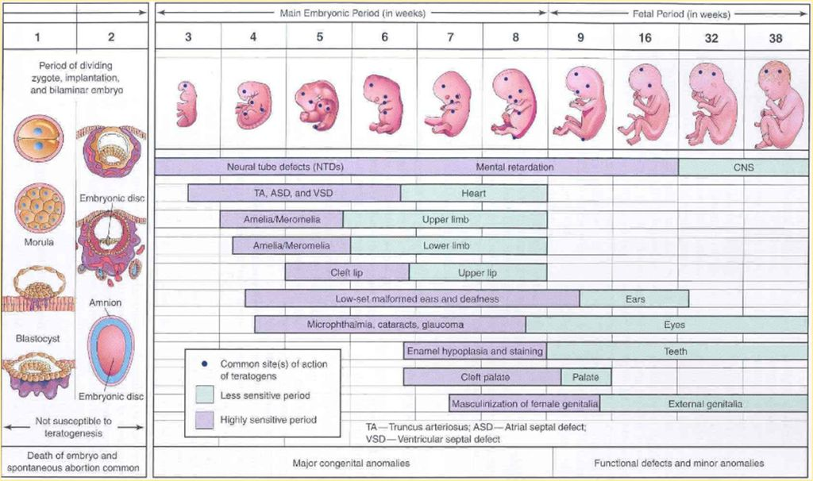
Developing Embryo and Fetus
Notes:
Maternal systems are vulnerable to alcohol
Maternal systems are vulnerable to alcohol and a developing embryo or fetus, which relies on the mother’s systems, is equally vulnerable. Alcohol freely crosses the placenta; the embryo or fetus is exposed to the same blood alcohol levels as the mother. The fetus is unable to detoxify any of the alcohol before it reaches and acts upon emerging cells and organs.
Three-way interaction
No single mechanism can explain all the harmful effects of alcohol on the developing fetus. The fetus prenatally exposed to alcohol is affected by a three-way interaction between; the amount or dose of alcohol, the timing of exposure, and postnatal environment (e.g., quality of home environment, exposure to violence, eligibility for services) interact to determine the full effects of exposure.
Areas in the fetus known to be affected by alcohol include skeletal structures, organs, central nervous system, and related rates of growth.
Central nervous system damage
Alcohol can damage the developing central nervous system through multiple actions including…
Interfering with the normal proliferation of nerve cells, increasing the formation of cell-damaging molecular fragments or free radicals, and altering the cell’s ability to produce or regulate cell growth, division, and survival.
Alcohol can impair the development and function of cells that guide the migration of nerve cells to their proper places, interfere with the normal adhesion of cells, alter the formation of axons, and alter cell membranes.
Finally, alcohol can alter the pathways of biochemical or electrical signals within cells, alter the regulation of calcium levels in the cells and alter the expression of certain genes.

Slide 9
Characteristics of FASD

Slide 10
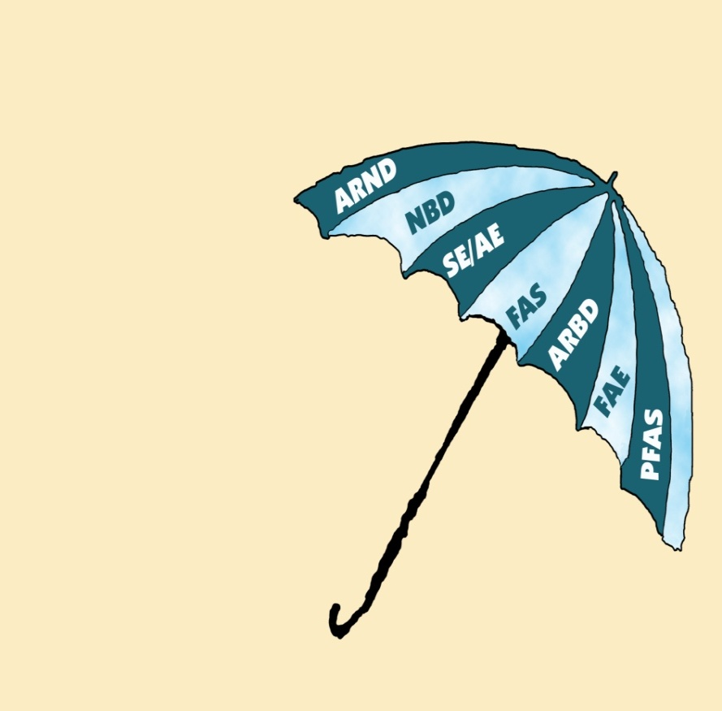
Terminology of FASD
Fetal alcohol spectrum disorders (FASD) is an umbrella term
Encompasses all conditions related to prenatal alcohol exposure (PAE)
Fetal alcohol syndrome (FAS) is one condition along the spectrum of FASD
Not all people with an FASD have physical signs of PAE
Fetal alcohol spectrum disorders
Image source: State of Alaska Division of Health and Social Services FASD 101: Insights into Fetal Alcohol Spectrum Disorders.
Notes:
Terminology
Before we move on with our discussion, we’ll review the terminology used in discussing FASDs. Since the 1970s, different researchers have observed the effects of prenatal exposure to alcohol and developed a variety of names for these effects, most of which are known by an acronym. The acronyms on the umbrella have all been used at some point to describe the effects of prenatal alcohol exposure – and many are still in use today.
FASDs is an umbrella term
Fetal Alcohol Spectrum Disorders is an umbrella term used to describe the range of effects that can occur in an individual whose mother drank alcohol during pregnancy.
These effects can include physical, mental, behavioral, and/or learning disabilities. These effects are life-long. Each person who is affected by pre-natal alcohol exposure is affected differently, so it’s important to look at the individual, not the term.

Slide 11
Terminology of FASD
Terms ‘FAS’ & ‘FASD’ are not interchangeable – FAS is a type of FASD.
Encompasses:
Fetal alcohol syndrome (FAS)
Alcohol-related neurodevelopmental disorder (ARND)
Static encephalopathy – alcohol exposed (SE/AE)
Partial FAS (P-FAS)
Fetal alcohol effects (FAE – outdated term)
Image source: State of Alaska Division of Health and Social Services FASD 101: Insights into Fetal Alcohol Spectrum Disorders.
Notes:
These terms include alcohol related neurodevelopmental disorder, neurobehavioral disorder (alcohol exposed), static encephalopathy/alcohol exposed, fetal alcohol syndrome, alcohol related birth defects, fetal alcohol effects, partial-fetal alcohol syndrome.
Fetal alcohol syndrome, or FAS, is a subset of FASDs. Since it is a medical diagnosis that involves a specific pattern of findings associated with in utero exposure to alcohol, we will devote a portion of our time today to this diagnosis.
Please keep in mind that it is not the only possible outcome of prenatal alcohol exposure, nor does it mean that individuals with a diagnosis of FAS have a greater disability than others who are prenatally exposed to alcohol. A diagnosis of FAS simply means that the individual has more outward or physical signs of the disability, in addition to nervous system problems.
In fact not having a diagnosis of FAS may in fact cause more problems for an individual through their lifetime.

Slide 12
Characteristics of FASD
Individuals with an FASD can have some combination or all of the following:
  Facial dysmorphia or other birth defects
  Growth restrictions
  Central nervous system dysfunction
Lack of recognition of primary disabilities can lead to secondary disabilities
Notes:
Characteristics of FAS
The characteristics discussed here are largely associated with those involved in a formal diagnosis of FAS; however, some of these features are also found in people who experience other FASDs besides FAS. Some features are required for a diagnosis of FAS, which we will talk about more later in the presentation.
The characteristics of FAS have been well documented. They include dysmorphia (especially of the facial features), growth restriction, and central nervous system related abnormalities.
Facial dysmorphia
Dysmorphia is defined as something that is out of proportion or misshapen. In relation to FAS, this means that an individual with this diagnosis has a certain set of facial features. Dysmorphic features that are a result of prenatal alcohol exposure are outward signs of abnormal cell development during the implantation, embryonic, or fetal states of gestation. These feature are clues to prenatal alcohol exposure, rather than formal diagnoses.
Physical Growth Restriction
Physical growth is affected on several levels by prenatal alcohol exposure. Both pre- and postnatal growth is limited, most notably in height and weight. Typically, fetuses are small for their gestational age and children with FAS are of short stature, underweight (failure to thrive), and/or have height or weight discrepancies.
Animal Research
There are limitations on the kinds of research appropriate for human subjects, so researchers have turned to animals to document the effects of fetal alcohol exposure. The chick on the right had alcohol injected into its egg during gestation. The chick on the left did not.
We see similar patterns of differences in humans. Animal research, like the study this chick was in, has confirmed that prenatal exposure to alcohol often leads to birth defects and functional problems.

Slide 13
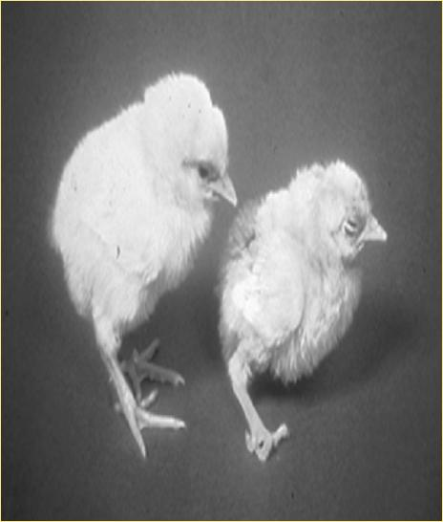
Reduced Physical Size
Prenatal and postnatal
Primary parameters for diagnosis
  Height
  Weight
Notes:
Physical Growth Restriction
Physical growth is affected on several levels by prenatal alcohol exposure. Both pre- and postnatal growth is limited, most notably in height and weight. Typically, fetuses are small for their gestational age and children with FAS are of short stature, underweight (failure to thrive), and/or have height or weight discrepancies.
The primary parameters of growth that need to be impaired to meet the growth retardation criteria for a diagnosis of FAS are height and weight.
Multiple factors can lead to growth deficiencies; for example, disruption of endocrine function leading to poor weight gain. These need to be considered by the physician or diagnostic team during the assessment or diagnostic process.
(Bertrand, J., Floyd, R. L., Weber, M. K., O’Connor, M., Riley, E. P., Johnson, K. A., et al. (2004). Fetal alcohol syndrome: Guidelines for referral and diagnosis. Atlanta, GA: Centers for Disease Control and Prevention.)
Animal Research
There are limitations on the kinds of research appropriate for human subjects, so researchers have turned to animals to document the effects of fetal alcohol exposure. The chick on the right had alcohol injected into its egg during gestation. The chick on the left did not.
Ask: What differences do you see? (feet, feathers, beak, eye, size)
We see similar patterns of differences in humans. Animal research, like the study this chick was in, has confirmed that prenatal exposure to alcohol often leads to birth defects and functional problems.

Slide 14
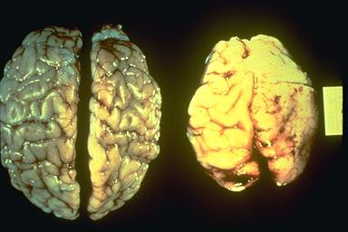
Reduced Head Circumference
Photo credit: Sterling Clarren, MD, Canada Northwest FASDs Research Network
Notes:
Brain Growth
Fetal alcohol exposure affects all regions of the brain, though some regions appear more vulnerable than others.
Through magnetic resonance imaging and additional technology, researchers have been able to document an overall reduction in brain size in children with FAS.
Further, several brain structures seem to be particularly susceptible to damage from prenatal alcohol exposure, including areas surrounding the interhemispheric fissure, the corpus callosum, the cerebellum, and the basal ganglia.
(National Institute on Alcohol Abuse and Alcoholism. (2000). 10th special report to the U.S. Congress on alcohol and health. Washington, DC: U.S. Department of Health and Human Services. NIH Pub No. 00-1583.)
Bring out the brain model here, if available.

Slide 15
CNS Dysfunction
Cognitive deficits
  Learning disabilities and memory problems
Executive functioning deficits
  Poor concentration and planning skills
Motor functioning deficits
  Clumsiness, balance problems, & tremors
Attention and hyperactivity
  Overactive, difficulty completing tasks, trouble with transitions
Social skill deficits
  Lack of stranger fear, immaturity
Notes:
Adverse effects on brain structures and development result in negative CNS effects and a wide variety of potential functional deficits.
Cognitive deficits (cognitive = thinking, reasoning, memory, imagination, learning)
These can include cognitive deficits, such as specific learning disabilities, poor academic achievement, discrepancy between verbal and nonverbal skills, slowed movements or reaction to people and stimuli.
Executive functioning deficits (executive functioning = brain processes that are responsible for planning, abstract thinking, rule acquisition, initiating appropriate actions, inhibiting inappropriate actions, sorting sensory information)
These can include executive functioning deficits, such as poor organization and planning skills, concrete thinking, lack of inhibition, poor judgment.
Motor functioning delays or deficits (motor function = how the parts of the body move together)
These can include motor functioning delays or deficits, such as delayed motor milestones, clumsiness, balance problems, tremors, poor dexterity, difficulty with writing or drawing).
Attention and hyperactivity problems
These can include distractibility, overactivity, difficulty completing tasks, trouble with transitions.
Social skills problems
These can include social skills problems, such as Lack of stranger fear, vulnerability to being taken advantage of, immaturity, superficial interactions, inappropriate choice of friends, poor social cognition).
Variation in functional abilities
Functional abilities vary greatly across individuals with FASDs since there is variation in the dose and timing of exposure as well as postnatal environmental influence, as noted previously. However, functional deficits from prenatal alcohol exposure are lifelong disorders that individuals never outgrow.
Some negative consequences of these deficits include disrupted school experiences, legal problems, incarceration, mental health problems, substance abuse, inappropriate sexual behavior, dependent living, poor employment history. Often these types of problems are referred to as secondary conditions.

Slide 16
Clinical Issues
Notes:
All health and allied health care providers need to participate in primary prevention efforts regardless of specialty. Contributions can include providing information about the dangers of drinking alcohol during pregnancy, screening women for risk of an alcohol-exposed pregnancy, and referring women with alcohol problems for appropriate treatment.

Slide 17
Prevention of FASD
Universal Prevention
  Public health message
Selective Prevention
  Women at increased risk of having an alcohol exposed pregnancy
Indicated Prevention
  Women at highest risk of having an alcohol exposed pregnancy
Notes:
Strategies aimed at preventing alcohol-exposed pregnancies include the following:
Universal prevention
Aims to educate the public about the dangers of alcohol use during pregnancy. Prevention strategies include warning labels on alcoholic beverages, public service announcements, and mass media campaigns.
Selective prevention
Targets individuals or a subgroup of the population who are at increased risk for having an alcohol-exposed pregnancy, meaning all women of childbearing age who drink alcohol. Prevention strategies include screening women for alcohol use and providing brief intervention for women at risk for an alcohol-exposed pregnancy.
Indicated prevention
Target women at highest risk for giving birth to a child with an FASDs, including women who have previously given birth to a child with an FASDs or a woman who has a known history of alcohol abuse or dependence. Prevention strategies include alcohol treatment and measures to prevent pregnancy.

Slide 18
Screening and Diagnosis of FASDs
Formal and informal screening
  Identify “triggers”
  Referral for diagnosis
Three major components of FAS diagnosis
  Facial dysmorphia
  Growth problems
  Central nervous system abnormalities
Differential diagnosis
Notes:
Formal and informal screening
The screening of children and persons with possible effects from prenatal alcohol exposure is an important step in the identification of FASDs. Various health and education professionals often formally and informally screen for FASDs. The purpose of such screening is to identify triggers—conditions known to be related to the presence of FAS or other related disorders. If enough triggers are present, referral to a diagnostic team to determine a diagnosis is the next step.
A diagnosis is best made within the context of a multidisciplinary assessment of the individual. In Alaska, this most often means a referral to an FASD Diagnostic Team.
Three major components of a diagnostic assessment
The FASD diagnostic team will look at:
Facial dysmorphia: smooth philtrum, thin vermillion border, and small palpebral fissures (at or below 10th percentile).
Growth problems: Confirmed prenatal or postnatal height or weight, or both, at or below the 10th percentile.
Central nervous system abnormalities: Documented structural, neurological, or functional problems in areas associated with prenatal alcohol exposure (e.g., attention, math, executive functioning).
In addition, the diagnosis should be characterized by the information available about exposure history as either confirmed prenatal alcohol exposure or unknown prenatal alcohol exposure.
Differential diagnosis
Because individual features are not unique to any specific syndrome, a process of differential diagnosis (ruling out other conditions) is essential for assessing all components of the diagnostic criteria. It is especially important to rule out environmental factors that can lead to growth problems, including poor nutrition, abuse and neglect, or even depression. (Bertrand, J., Floyd, R. L., Weber, M. K., O’Connor, M., Riley, E. P., Johnson, K. A., et al. (2004). Fetal alcohol syndrome: Guidelines for referral and diagnosis. Atlanta, GA: Centers for Disease Control and Prevention.)
CNS (central nervous system) abnormalities are often the most challenging component of differential diagnosis. Individuals with many other conditions have functional deficits that are similar to those of FAS at a general level, but they are not completely identical.
For example, both children with FAS and children with attention-deficit/hyperactivity disorder (ADHD) have diagnosable attention problems, but children with FAS have difficulty with flexibility of attention and encoding information, whereas children with ADHD have problems with focus and maintaining attention.
In addition to establishing the presence of FAS, a complete diagnosis needs to identify and specify other disorders that can co-exist with FAS. These include autism, anxiety disorders, adjustment disorders, sleep disorders, and depression. (Bertrand, J., Floyd, R. L., Weber, M. K., O’Connor, M., Riley, E. P., Johnson, K. A., et al. (2004). Fetal alcohol syndrome: Guidelines for referral and diagnosis. Atlanta, GA: Centers for Disease Control and Prevention.)

Slide 19
Treatment and Therapy
Early intervention
  Begins with diagnosis
  Prevents secondary disabilities
Protective factors
  Stable and nurturing home environment
  Early diagnosis (before age 6)
  Absence of exposure to violence
  Consistency in caregivers
  Eligibility for social and educational services
Interdisciplinary approach to treatment and therapy
Notes:
Diagnosis
Diagnosis is part of a continuum of care that identifies and facilitates appropriate health care, education, and community services as needed.
Early intervention
Early intervention is critical in the treatment of any disorder. This means providing treatment not only for young children, but also for older individuals as soon as problems are identified.
Protective factors (protective factor = anything that prevents or reduces the risk for the development of a disorder or problem)
In addition, some protective factors against secondary conditions or disabilities have been identified: a stable and nurturing home environment during the school years, early diagnosis (before 6 years of age), absence of exposure to violence, consistency in caregivers, and eligibility for social and educational services. (Streissguth, A. P., Barr, H. M., Kogan, J. & Bookstein, F. L. (1996). Understanding the Occurrence of Secondary Disabilities in Clients with Fetal Alcohol Syndrome (FAS) and Fetal Alcohol Effects (FAE). Final Report to the Centers for Disease Control and Prevention (CDC). Seattle: University of Washington, Fetal Alcohol & Drug Unit. Tech. Rep. No. 96-06.)
(Primary disabilities are those that an individual is born with. They reflect differences in brain structure and function. Secondary disabilities are those that the individual is not born with, that result from the lack of recognition or support for the primary disability. Some secondary disabilities are academic challenges, mental health problems, substance abuse problems.)
Because an individual with an FASD is the product of a unique interaction between the dose and timing of alcohol exposure, as well as their experiences, the service needs of affected individuals and their families can differ. (That is, each individual with an FASD is affected differently.) However, some general areas of service and specific services have been identified that are universally beneficial: a nurturing and structured care giving environment, parent and service provider education about FASDs, and a thorough multi-disciplinary evaluation to identify individual strengths and weaknesses. (Streissguth, A. P. (1997). Fetal Alcohol Syndrome: A Guide for Families and Communities. Baltimore: Paul Brookes Publishing Co.)
It is very important to remember that families and caregivers are essential in the treatment planning process. (Mitchell, K. T. (2002). Fetal alcohol syndrome: Practical suggestions and support for families and caregivers. Washington, DC: National Organization on Fetal Alcohol Syndrome.)
Interdisciplinary approach
Depending on the needs of the person with an FASD, the treatment team might include a dysmorphologist; geneticist; neurologist; primary care physician; pediatrician; ophthalmologist; ear, nose, and throat specialist; immunologist; plastic surgeon (if cleft lip or palate exists); endocrinologist; gastroenterologist; psychiatrist; psychologist; social worker; special educator; nutritionist; audiologist; speech-language pathologist; occupational therapist; and physical therapist.

Slide 20
Prevalence and Demographics

Slide 21
Prevalence of FAS
Prevalence of fetal alcohol syndrome (FAS) in the United States
  0.2 to 1.5 per 1,000 live births
Prevalence higher in some disadvantaged groups
  Some minority groups have higher documented prevalence
  Children in foster care
  Youth in justice system
Prevalence of FASDs in the United States
  9-10 per 1,000 live births
Notes:
Prevalence of FAS
CDC reports FAS prevalence rates from 0.2 to 1.5 cases per 1,000 births across various populations in certain parts of the United States. These rates are comparable to or greater than other common developmental disabilities such as Down syndrome or spina bifida.
(Centers for Disease Control and Prevention. (2002). Fetal alcohol syndrome—Alaska, Arizona, Colorado, and New York, 1995-1997. Morbidity and Mortality Weekly Report, 51, 433–435; May, P. A., & Gossage, J. P. (2001). Estimating the prevalence of fetal alcohol syndrome: A summary. Alcohol Research and Health, 25(3), 159–167.)
Using this range of prevalence, of the approximately 4 million infants born each year, an estimated 800 to 6,000 will be born with FAS.
(Bertrand, J., Floyd, R. L., Weber, M. K., O’Connor, M., Riley, E. P., Johnson, K. A., et al. (2004). Fetal alcohol syndrome: Guidelines for referral and diagnosis. Atlanta, GA: Centers for Disease Control and Prevention.)
Disadvantaged groups, American Indians/Alaska Natives, and other minorities have been documented to have prevalence rates as high as 3 to 5 cases of FAS per 1,000 children. (Sampson, P. D., Streissguth, A. P., Bookstein, F., Little, R. E., Clarren, S. K., Dehaene, P., et al. (1997). Incidence of FAS and prevalence of ARND. Teratology, 56, 317–326.)
Among children in foster care, the prevalence rate for FAS is 15 cases per 1,000 children. (Astley, S. J., Stachowiak, J., Clarren, S. K., & Clausen, C. (2002). Application of the fetal alcohol syndrome facial photographic screening tool in a foster care population. Journal of Pediatrics, 141(5),712–717.)
Finally, among individuals in the juvenile justice system, more than 200 per 1,000 (20%) were found to have FAS or a related disorder. (Fast, D. K., Conry, J., & Loock, C. A. (1999). Identifying fetal alcohol syndrome among youth in the criminal justice system. Journal of Developmental & Behavioral Pediatrics, 20(5), 370–372.)
Prevalence of FASDs
Some researchers have estimated the rates of the full range of FASDs to be as high as 9 or 10 per 1,000 live births. This translates to about 40,000 alcohol-affected births per year in the United States.
(May, P. A., & Gossage, J. P. (2001). Estimating the prevalence of fetal alcohol syndrome: A summary. Alcohol Research and Health, 25(3), 159–167; Sampson, P. D., Streissguth, A. P., Bookstein, F., Little, R. E., Clarren, S. K., Dehaene, P., et al. (1997). Incidence of FAS and prevalence of ARND. Teratology, 56, 317–326; Lupton, C., Burd, L., & Harwood, R. (2004). Cost of fetal alcohol spectrum disorders. American Journal of Medical Genetics Part C (Seminars in Medical Genetics), 127C, 42–50.)

Slide 22
Prevalence of FASD in Alaska
Prevalence 1996-2011*
  FAS prevalence: 1.5 per 1,000 live births
  FASD prevalence: 11.3 per 1,000 live births
Prevalence higher in some disadvantaged groups
  Higher DOCUMENTED prevalence
Challenges to documentation:
  Data collection, under/over reporting
*Chidambaram & Bisson (2013) Alaska Birth Defects Registry: Critical Factors and Considerations in Reporting Information. Presented at FASD: Best Practices in the Last Frontier, Anchorage, AK, May 2013.
Notes:
For children born in Alaska from 1996 to 2011 (the most recent cohort analyzed), the overall FAS prevalence rate was 1.5 per 1,000 live births (down from 2 per 1,000 live births previously).
It is estimated that the prevalence of FASDs in Alaska is approximately 11.3 per 1,000 live births. (Chidambaram & Bisson, 2013).
There is a higher documented prevalence rate among some disadvantaged groups in Alaska. For example, the FAS prevalence rate among Alaska Native groups is 3.2 per 1,000 live births. (This is a substantial decrease from the previous prevalence rate of 6.3 per 1,000 live births, indicating that there was been a lot of hard work and success in Alaska Native communities in prevention and community education about FASDs.)
(Note that the Alaska Native community may be better at documenting FAS than other groups.)
In the most recent cohort however, the FAS prevalence in non-Native groups increased from 0.4 per 1,000 to 0.6 per 1,000.
FASDs can occur in ANY community if there is alcohol consumption by women during pregnancy.
FAS Surveillance Network
Alaska was part of a five state FAS surveillance network called FASSNet. This network was a collaborative effort between these five states and the Centers for Disease Control and Prevention.
FASSNet developed a standardized surveillance case definition for fetal alcohol syndrome. This means that they used the same method to arrive at the FAS prevalence rates in these states. In Alaska, this prevalence rate is based on information reported to the Alaska Birth Defects Registry; it is a state requirement for physicians to report cases of FAS to this state-wide database. This database is located at the Women’s, Children’s and Family Health department of the state division of health and social services.
(Note that this talks about FAS rates NOT rates of FASDs.)
There is a higher documented prevalence rate among some disadvantaged groups in Alaska. For example, the FAS prevalence rate among Alaska Native groups is 3.2 per 1,000 live births. (This is a substantial decrease from the previous prevalence rate of 6.3 per 1,000 live births, indicating that there was been a lot of hard work and success in Alaska Native communities in prevention and community education about FASDs.)
(Note that the Alaska Native community may be better at documenting FAS than other groups.)
FASDs can occur in ANY community if there is alcohol consumption by women during pregnancy.
(Schoellhorn, J. (2010) Decline in the birth prevalence of fetal alcohol syndrome in Alaska. State of Alaska Epidemiology Bulletin 3 (February 17, 2010); Schoellhorn, J. & Podvin, D. (2002) Fetal alcohol syndrome prevalence in Alaska: New findings from the FAS surveillance project. Family Health Dataline 8(2):1-6, published by the Alaska Department of Health and Social Services, Division of Public Health Section of Maternal, Child, and Family Health.)

Slide 23

FAS Around the World
Russian orphanages
  15 per 1,000 live births
Rural South Africa
  41 to 46 per 1,000 live births
Surveillance of FAS
  Inconsistent and difficult
  Prevalence difficult to accurately estimate
Notes:
Alcohol consumption is a worldwide public health issue and, as would be expected, countries that have high rates of alcohol consumption also have high rates of FAS.
Russian orphanages
In Russia, which has very high rates of alcoholism, prevalence of FAS among children in orphanages is estimated to be 15 cases per 1,000. (Miller, L. C., Chan, W., Litvinova, A., Rubin, A., Comfort, K., Tirella, L., et al. (2006). Fetal alcohol spectrum disorders in children residing in Russian orphanages: a phenotypic survey. Alcoholism: Clinical & Experimental Research, 30(3), 531–538.)
Rural South Africa
In South Africa, the production and sale of alcohol is promoted as an important economic activity.
South Africa has the highest reported birth prevalence for FAS with reports of 41 to 46 cases per 1,000 live births.
Rates of FAS are particularly high in rural areas of South Africa where many workers are involved in wine production
(May, P. A., Gossage, J. P., Marais, A. S., Adnams, C. M., Hoyme, H. E., Jones, K. L., et al. (2007). The epidemiology of fetal alcohol syndrome and partial FAS in a South African community. Drug and Alcohol Dependence, 88(2-3), 259–271; Viljoen, D. L., Gossage, J. P., Adnams, C. M., Jones, K. L., Robinson, L. K., Hoymen, H. E., et al. (2005). Fetal alcohol syndrome epidemiology in a South African Community: a second study of a very high prevalence area. Journal of Studies in Alcohol, 66, 593–604.)
Surveillance of FAS
Although true differences in rates for FAS certainly exist, some of the variation might be due to challenges in estimating FAS prevalence.
First, no specific and uniformly accepted diagnostic criteria have been available for FAS. Second, FAS diagnosis is based on clinical examination of features, but not all children with FAS look or act the same. Third, many primary care providers lack knowledge of and have misconceptions about FAS. Fourth, there are no diagnostic criteria to distinguish FAS from other prenatal alcohol-related conditions (Bertrand et al., 2004). Finally, studies in the United States have used a record review methodology, which clearly underestimates the prevalence of the disorder.
This is demonstrated by a recent study in Italy, which used a direct evaluation method for school children and found rates of 4 to 7 cases per 1,000 children (May et al., 2006).

Slide 24
Monitoring Prenatal Alcohol Use
Women of childbearing age (age 18-44 years)
  54% report alcohol use
  12% report binge drinking
Pregnant women (age 18-44 years)
  10% report drinking alcohol
  At least 2% report binge drinking
Risk of giving birth to child with FASDs depends of multiple factors
  Pattern, volume, time, and duration of alcohol use
  Demographic factors
Notes:
In the United States, more than half (54%) of all women of childbearing age (18–44 years of age) report some alcohol use, and one in eight (12%) reports binge drinking in the past 30 days.
In addition, 12% of pregnant women report consuming any alcohol, and 2% report binge drinking in the past 30 days.
(Centers for Disease Control and Prevention (2009) Alcohol use among pregnant and nonpregnant women of childbearing age – United States, 1991-2005. Morbidity and Mortality Weekly Report 558(19):529-532 (May 22, 2009) www.cdc.gov/mmwr/preview/mmwrhtml/mm5819a4.htm?s_cid=mm5819a4_e)
The risk of a woman giving birth to a child with an FASDs depends on multiple factors, such as the pattern, volume, timing, and duration of alcohol use.
Additional maternal risk factors might include age, race, ethnicity, socioeconomic status, nutrition, alcohol metabolism, genetic sensitivity to alcohol, and possible interactions among these factors.
(Tsai, J., Floyd, R. L., Green, P. P., & Boyle, C. A. (2007). Patterns and average volume of alcohol use among women of childbearing age. Maternal and Child Health Journal, 11(5), 437–445.)

Slide 25
Cost of FAS
Cost estimates only available for FAS
Total annual costs associated with FAS in US about $4 billion dollars
About 2 million dollars per one individual with FAS
Notes:
Cost estimates only available for FAS
The costs of FASDs are beginning to be understood and formally addressed. To date, cost estimates are only available for FAS.
Total annual costs associated with FAS in US
Annual costs associated with FAS in the United States are estimated to be approximately $4 billion.
Estimate for one individual with FAS
In 2002, the estimated lifetime cost for one individual with FAS was $2 million. This is an average for all people with FAS. Those with severe problems, such as profound mental retardation, have much higher costs.
(Lupton, C., Burd, L., & Harwood, R. (2004). Cost of fetal alcohol spectrum disorders. American Journal of Medical Genetics Part C (Seminars in Medical Genetics), 127C, 42–50.)

Slide 26
Psycho-Social-Cultural Effects

Slide 27

Psychosocial Aspects
Increased health care needs across the lifespan
Functional problems
  Mental health difficulties
  Disrupted school experiences
  Trouble with law
  Difficulties with independent living
  Substance abuse
  Problems with parenting
Notes:
FASDs are considered birth defects and developmental disabilities, and persons with these conditions have increased health care needs from birth through adulthood.
In addition, individuals with FASDs are at very high risk for injury, unintended pregnancy, and sexually transmitted infections.
The most severe impact arises from functional problems, including mental health difficulties, disrupted school and job experiences, trouble with the law, difficulties with independent living, substance abuse, problems with parenting, and more.
Everyday needs such as transportation, job assistance, and housing compete within already overburdened social services.
Some individuals with FASDs qualify for federal assistance, such as Medicaid, Supplemental Security Income (SSI), and Section 8 Housing subsidies.

Slide 28
Psychosocial Aspects
Support needed for family and individual with an FASD
FASD are lifelong disorders
Many of the secondary disabilities may be preventable through early intervention
Fetal alcohol spectrum disorders
are entirely preventable if no alcohol is consumed during pregnancy!
Notes:
FASDs have serious and often devastating effects on the patient and family.
Disabilities are experienced by the affected person from infancy through adulthood.
Many families face complex situations and might present with numerous health and social problems.
Parents of individuals with an FASDs report clinically elevated levels of stress.
FASDs raise unique treatment issues and the need for family support within many systems, including medical and health care, early intervention and education, juvenile justice and corrections, substance abuse treatment, mental health, and social services.

Slide 29
In closing…
Review:
Biomedical foundation of FASD
Prevalence and demographics of FASD
Characteristics of FASD
Assessment, diagnosis, and clinical issues and FASD
Psychological, social, and cultural aspects of FASD
Notes:
Review content and open for questions, comments, and discussion.

Slide 30


Arctic FASD Regional Training Center www.uaa.alaska.edu/arcticfasdrtc arcticfasdrtc@uaa.alaska.edu
907.786.6381
The Arctic FASD Regional Training Center is a project of the UAA Center for Behavioral Health Research & Services.
Funding for this project is provided by CDC Cooperative Agreement #U84DD000886-01.

