Slide 1


Fetal alcohol spectrum disorders: Biological effects of alcohol on fetus
The Arctic FASD Regional Training Center is a project of the
UAA Center for Behavioral Health Research & Services.
Funding for this project is provided by CDC Cooperative Agreement #U84DD000886-01.
Notes:
This PowerPoint was created by the University of Alaska Anchorage Center for Behavioral Health Research & Services’ CDC-funded Arctic FASD Regional Training Center in 2010 and revised in 2013. The content is based primarily on materials and resources available in CDC’s Fetal Alcohol Spectrum Disorders Competency-Based Curriculum Development Guide for Medical and Allied Health Education and Practice (2009).
This guide was revised in 2015 and is available from www.frfasd.org/Comp_Guide.html.
If you are using elements of this PowerPoint in another presentation, please credit the Arctic FASD Regional Training Center and the 2009 Fetal Alcohol Spectrum Disorders Competency-Based Curriculum Development Guide for Medical and Allied Health Education and Practice.
Questions about this PowerPoint or its contents should be addressed to the Center for Behavioral Health Research & Services at the University of Alaska Anchorage – www.uaa.alaska.edu.
Funding was provided by the Centers for Disease Control and Prevention (CDC) to the Center for Behavioral Health Research and Services (CBHRS) at the University of Alaska Anchorage. The goal of the Arctic FASD FASD Regional Training Center was to increase awareness about FASD among health and allied health students and professionals.
The CDC has identified seven core competencies that enable professionals to more effectively prevent, identify, and treat FASDs.
This presentation covers competency four, biological effects of alcohol on the fetus.

Slide 2
Road map for presentation
Alcohol metabolism and pharmacology
Birth defects associated with alcohol use
Alcohol-induced injuries on developing nervous system
Cellular response to alcohol exposure
Biomedical mechanisms
Neurobehavioral effects
Notes:
Road Map for Presentation
In today’s workshop we will be discussing alcohol metabolism and pharmacology, the birth defects associated with prenatal alcohol exposure, how alcohol can injure the developing nervous system, the cellular response to alcohol exposure, the biomedical mechanisms involved, and the effects of fetal alcohol exposure on neurobehavior.
By the end of today’s workshop you will be able to:
Define the amount of alcohol in a drink.
Explain alcohol metabolism and pharmacology (absorption, distribution, metabolism, and elimination)
Describe birth defects associated with alcohol use.
Describe alcohol-induced injuries on developing organ systems.
Describe the cellular responses to alcohol exposure.
Explain the putative biomedical mechanisms.
Explain the effects of ethanol exposure on neurobehavioral outcomes, specifically those that are cognitive and psychiatric/behavioral.
Describe genetic variants and markers for susceptibility for FASDs.

Slide 3
Amount of alcohol in a drink

Slide 4
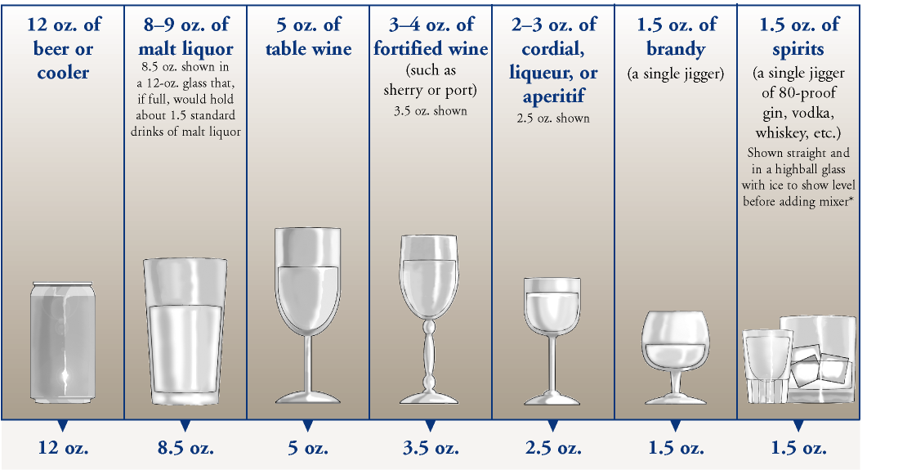
A standard drink
Notes:
A clear understanding of the quantity of alcohol consumed is important in assessing risk. Determining the amount of alcohol exposure can be difficult, however, because of cultural and societal differences in what constitutes a ‘drink’.
The molecular nature of alcohol (ethyl alcohol) is very easily soluble in water in various concentrations and volumes. This means responses to a general question about ‘drinks consumed’ might result in imprecise information about the total amount of alcohol consumed in a drinking session or by a person at risk of alcoholism.
Volume
Let’s start with a quick discussion about what a standard drink is.
To evaluate a rough equivalency of alcoholic beverages, it is important to consider the concentration of alcohol used in the beverage as well as the volume.
For example, NIAAA guidelines (2005) use the following beverage types and volumes as rough equivalencies for standard drinks:
One 12-ounce (355 ml) can or bottle of beer
One 5-ounce glass of wine
One 12-ounce wine cooler
One 4-ounce glass of sherry, liqueur or aperitif
One “shot” of liquor (distilled alcVoluohol), 1.5 ounces
Quantity of alcohol
The quantity of alcohol in each of the drinks on this slide is approximately equal. This is easily determined by estimating the percent alcohol used in the drink (e.g., beer = 3%–5% by volume).
Simple calculations indicate that one can of beer contains approximately 11 ml of alcohol (355 ml x 0.03), and within the 11 ml there is approximately 8.7 g of alcohol (11 ml x 0.789 g/ml).
Each of the drinks on this slide contains 8–10 grams of alcohol (roughly). The exception is the “shot” of spirits. While 1–1.5 ounces is commonly used in a “mixed drink,” the percent alcohol contained within the shot is variable with some spirits being 30% alcohol, and other spirits being 80% or more.
Although the high end of 10 grams of alcohol in one mixed drink would be a reasonable estimate, one must be aware that it could be greater depending on the spirits used in the drink.

Slide 5
Alcohol metabolism and pharmacology

Slide 6
Alcohol metabolism
Woman takes a
drink of alcohol
Alcohol
introduced
to stomach
Absorption
occurs
rapidly
Peak blood alcohol level about 1 hour after consumption
Absorption depends on several factors
    E.g., food consumption, body mass
Gender differences: women attain greater blood ethanol concentrations than men
Notes:
Metabolism = the processing of a substance within the living body
Pharmacology = the study of drugs and how the body reacts to them, and how they react to the body
When a woman takes a drink, the ethanol in that drink is introduced into the stomach where absorption and metabolism of the molecule (C2H5OH) occurs rapidly. How quickly the alcohol is absorbed into the body might be influenced by other contents in the stomach. It is most rapidly absorbed from an empty stomach.
Peak blood ethanol concentrations are attained approximately 1 hour after consumption of the beverage. But this might vary depending on a number of factors, including:
the rate at which the alcoholic beverage was consumed
whether or not it was consumed with other substances, such as food
and the individual’s rate of gastric emptying and body type (also known as body habitus, whether a person is underweight, normal weight, or overweight)
Gastric emptying = speed at which food and drink leave the stomach
It has been demonstrated that, given the same amount of alcohol under standardized conditions, women attain consistently greater blood ethanol concentrations than men following equivalent amounts of ethanol consumption.
This fact is largely the result of two factors.
1. Women’s body water (the compartment in which the ethanol distributes) is significantly smaller than that of men.
2. Women have a higher rate of alcohol absorption from the stomach than do men.
This fact is important given its significance to the embryo or fetus if the woman is pregnant.

Slide 7
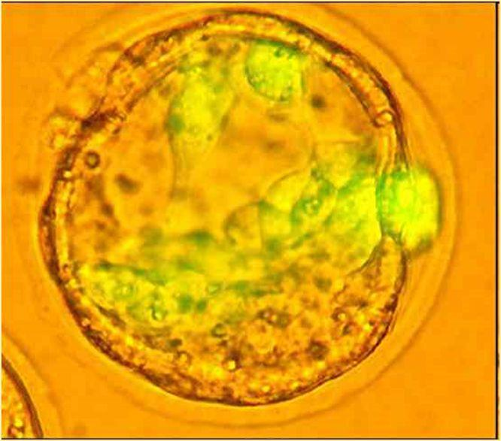
Distribution of alcohol
Compartmentalization
Alcohol soluble in water
Cell is 98% water
Alcohol easily crosses cell membranes
Notes:
Compartmentalization
Body mass might be thought of as either water or non-water compartments.
The content of the cell is nearly 98% water; because of alcohol’s rapid solubility in water, it can easily cross cell membranes into the cell.
Alcohol is less soluble into lipids (fats) and compartments with substantial lipids; these non-water compartments are less readily affected by alcohol.
Absorption of alcohol from the stomach and gastrointestinal system into the blood vascular system occurs rapidly.
Alcohol then moves readily through the compartments that have higher water content, such as the blood plasma, extracellular fluids, and intracellular fluids.
It is distributed throughout most organs of the body, including the musculoskeletal system, liver, kidney, heart, breasts and, most apparent, the nervous system.

Slide 8
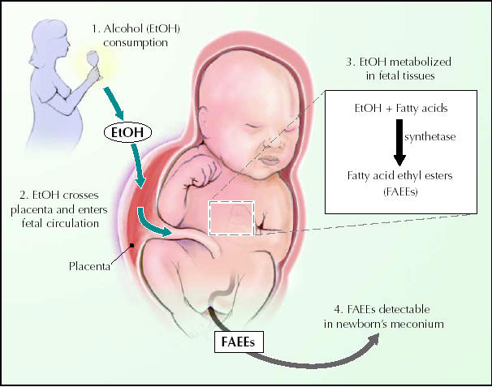
Placental effects
Placenta acts as selective barrier
Alcohol passed from maternal to fetal blood
Notes:
Placental effects and fetal distribution
Normally there is no mixing of maternal and fetal blood.
However, the capillaries (very small blood vessels) containing the maternal blood and those containing the fetal blood are separated only by a minute barrier in the placenta. This makes the exchange of oxygen and nutrients from the mother to the fetus and carbon dioxide and wastes from the fetus to the mother much easier.
The placenta therefore, acts as a selective barrier. That is, it lets some things through, but keeps other things out. Unfortunately, the placenta does not discriminate among some substances, such as some drugs and viruses.
Because of its physical properties, alcohol is easily passed by diffusion from the maternal blood into the fetal blood. Once the alcohol is absorbed into the fetal circulation, it is distributed by the fetal blood vascular system throughout the fetal tissues in much the same manner as it is distributed in the mother.
The alcohol partitions among the compartments just like the mother with alcohol reaching concentrations in nearly all tissues similar to that of the mother.
The embryo has limited ability to metabolize alcohol, mostly because of the status of the development of the liver and enzymes responsible for metabolism of ethanol.
Much of the ethanol that is passed from the mother into the embryo is eliminated (removed) from the embryo by diffusion back into the mother for metabolism and elimination.

Slide 9
Metabolism and elimination
Genetic variation
  May influence alcohol consumption
Fetal metabolism
  Placenta does not metabolize ethanol well
  Early stages of development very susceptible to damage
Notes:
Metabolism and elimination
Alcohol (ethanol) is metabolized by enzymes. Most of the ethanol is metabolized in the liver; less than 10% is eliminated in the urine or by the lungs. The liver cells (hepatocytes) contain three pathways for the metabolism of ethanol (three ways that alcohol is processed for removal from the body). We will only touch on these briefly.
Alcohol dehydrogenase (ADH) pathway.
Microsomal ethanol oxidizing system (MEOS) pathway.
Catalase pathway
Metabolism of alcohol occurs mainly through the first pathway, the ADH pathway. However, chronic (ongoing) alcohol exposure may increase the use of the other pathways.
All pathways lead to the same product, acetaldehyde. The acetaldehyde is in turn processed by an enzyme called acetaldehyde dehydrogenase (ALDH). ALDH metabolises (processes) the acetaldehyde into acetate, which then can be metabolized into carbon dioxide and water.
Acetaldehyde and ALDH are significant to alcohol consumption since acetaldehyde has been shown to have systemic effects, such as general vasodilation (flushing) and general malaise (discomfort, uneasiness, feeling unwell). This means that one of characteristics of acetaldehyde is that affects the entire body.
Genetic variation
Genes can come in different variations (alleles). Variants of the ALDH gene might influence ethanol consumption in some populations. Individuals carrying the variant form of the gene (allele) have a markedly reduced capacity to metabolize acetaldehyde resulting in some individuals’ having a reduced propensity to consume alcohol.
So if you have a certain variation or allele of the gene that is responsible for creating the enzyme ALDH, you may not be able to process acetaldehyde (a reduce capacity for metabolizing alcohol) as well as other people. This would affect how much alcohol your body feels comfortable consuming. If you don’t feel good drinking alcohol, you may be less likely to consume it.
Fetal metabolism
Numerous scientific studies have been performed in animals and humans to attempt to determine the amount of alcohol metabolized by either the placenta or the fetus. Best estimates indicate the placenta does not metabolize ethanol well. These studies also suggest that the capacity for ethanol metabolism by the embryo or fetus increases with gestational age. (That is, as the organs develop, they gradually increase their ability to process alcohol.)
Because the liver cell (hepatocyte) performs most of the alcohol metabolism through the ADH pathway, these enzymes must be present and active for the fetus to be able to effectively metabolize alcohol. An embryo or early fetus lacks the enzymes for metabolism, so the mother must metabolize most of the alcohol.
The alcohol in the embryo or early fetus must diffuse back into the mother for oxidation and elimination. Because removal of the alcohol in the embryo occurs by simple diffusion to the mother, during the metabolism phase, embryonic alcohol levels might be higher than in the mother and be present for a more prolonged, but variable time.
The length of time that the fetus is exposed to alcohol (before it is fully diffused back to the mother) and the time that exposure might occur could be significant to the developing embryo or fetus.
(Diffusion = process by which molecules spread from an area of high concentration to area low concentration)

Slide 10
Neuromorphological Birth defects associated with alcohol use
Notes:
Nervous system = organ system; contains a network of specialized cells (neurons) that coordinate the actions of an animal and transmit signals between different parts of the body. Usually has two parts:
Central = brain, spinal cord, retina (eye)
Peripheral = sensory neurons around the body
Neuromorphology = study of how the nervous systems form and how they communicate with and affect one another.
Neuromorphological = relating to neuromorphology
Neuro = nerves/nervous system
Morphology = study of form or structure
So, neuromorphological birth defects = the study of birth defects associated with the formation of and communication within and between the nervous systems (central & peripheral).
Neuron = nerve cell, transmits information by electrical and chemical signals. Neurons connect together to form networks. Signaling between neurons occurs via synapses. There are some types of specialized neurons: sensory neurons respond to the senses (touch, sound, light, smell, etc.), motor neurons (cause muscles to contract & relax).

Slide 11
Prenatal alcohol exposure & the brain
All areas of the brain are susceptible to damage
  E.g., cerebral cortex, cerebellum, cerebellar cortex, hippocampus
Craniofacial malformations
  May be due to embryological changes in brain development
Notes:
To describe the neuromorphological birth defects associated with fetal alcohol syndrome, one must consider the effects of alcohol on neural and cognitive development and understand how molecular and cellular effects result in morphological and functional changes.
(cognitive = thinking, reasoning, memory, imagination, learning; neural = relating to nerves)
Early studies were descriptive in nature, attempting to determine which part or parts of the nervous system affected by fetal alcohol exposure contributed to the constellation of features associated with FAS.
Multiple studies found that gross morphological changes were present in the brains of individuals who have FAS. These included significant developmental abnormalities in the cerebral cortex, such as microcephaly, hypoplastic or atrophic gyri and sulci, malformed or displaced gyri, porencephaly, and other malformations.
(Presenters, if available, bring out the brain model here.)
Similar malformations have been described in the cerebellum, cerebellar cortex, and hippocampus. Indeed, it seems no area of the brain is resistant to the effects of fetal alcohol exposure. Similar malformations were observed in animal models subjected to fetal alcohol exposure.
More recent investigations into the morphological changes that occur as a result of fetal alcohol exposure indicate the presence of significant changes in the corpus callosum, the major connecting pathway between the two halves of the cerebral cortex. Fetal alcohol exposure might cause predictable alterations in the corpus callosum structure that are detectible by magnetic resonance imaging (MRI) or sonography.
An animal study has shown that the craniofacial malformations associated with FAS might be explained by embryological changes that occur in development of the brain and the facial structures. Indeed, exposure of mice to alcohol during development resulted in features similar to FAS in humans (e.g., microcephaly and a reduced head circumference, smaller palpebral fissures, and the reduction of the philtrum and upper lip structures).
That is, the facial changes seen in individuals who experience FAS may be a reflection of changes to the brain.

Slide 12
Fetal alcohol spectrum disorders (FASD)
Fetal alcohol spectrum disorders
  Encompasses all diagnoses related to prenatal alcohol exposure
  Includes fetal alcohol syndrome (FAS)
  More than one of the features associated with FAS
  Not sufficient features to make a diagnosis of FAS
  Includes alcohol-related neurodevelopmental disorder (ARND)
Individuals with FASDs have been exposed to alcohol in utero
  Secondary behavioral and cognitive effects result
Notes:
Fetal alcohol spectrum disorders (FASDs) is a term referring to individuals who have more than one of the features associated with FAS but do not exhibit sufficient features to make a clear FAS diagnosis. (That is, individuals with an FASD have some, but not all, features that are required to be present for a diagnosis of FAS. For example, and most commonly, they do not have the facial features that are considered characteristic of FAS, but they do have central nervous system problems such as problems with cognitive or executive functioning.) Included within this terminology is alcohol-related neurodevelopmental disorder (ARND).
It is important to note that FASDs is a term that includes children who have been exposed to alcohol during fetal development. Although they might not have craniofacial effects of FAS, they may have secondary behavioral and cognitive effects resulting from the alcohol exposure.

Slide 13
Alcohol-Induced Injuries on the Central Nervous System (CNS)
Notes:
Neuron = nerve cell, transmits information by electrical and chemical signals. Neurons connect together to form networks. Signaling between neurons occurs via synapses. There are some types of specialized neurons: sensory neurons respond to the senses (touch, sound, light, smell, etc.), motor neurons (cause muscles to contract & relax).
(Presenters, this is a good time to play either the excerpt from The Brain DVD or the YouTube clip explaining how alcohol can affect the development of facial features.)

Slide 14
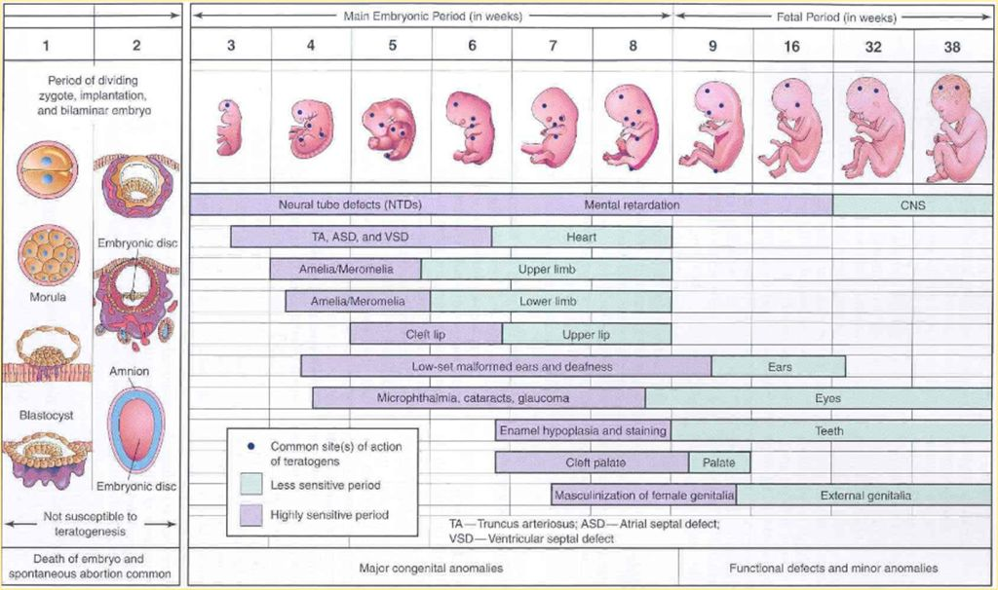
Sensitivity throughout gestation
Notes:
Development of the nervous system begins in about the 3rd week of gestation and continues throughout gestation.
An estimated 95–100 billion neurons (nerve cells) are found in the human cortex, making the rate of generation nearly 250,000 new neurons formed each minute of the 9-month gestational period in the cortex alone.
That calculation assumes a continuous rate of generation over the 40-week period. However, studies have shown that the nervous system develops in a discontinuous manner with periods of greater developmental activity followed by periods of relative quiescence in development. (That is, the nervous system has times when it is developing quickly and other times when development occurs more slowly.)
Logic suggests that the presence of ethanol might have more significant effects during periods of rapid growth than during periods of relatively slow growth—if one considered only neurogenesis (birth of new neurons).
During neuron development, however, multiple processes are occurring, such as migration, synapse formation, and myelination. Significant activity remains in the maturation of the nervous system throughout pregnancy that might be affected by the presence of alcohol. Undoubtedly, the presence of alcohol in the first few weeks of gestation might result in the most devastating effects, such as spontaneous abortion.
This is because of the limited number of cells present in the embryo and the totipotency (the ability of a single cell to divide and produce all the differentiated cells in an organism) of each cell at that time. The loss or damage of even a few cells at that critical time might result in global changes in the development of organs at a later phase.

Slide 15
Sensitivity throughout gestation
Notes:
During the second and third trimesters, the tissues and organs have been largely formed. Some organs and systems, however, remain susceptible to potential damage or alteration caused by the presence of ethanol.
The nervous system is one such system. Its long period of development increases its vulnerability to the teratogenic effects of alcohol and other drugs. The same is true for the eyes and ears, portions of which are extensions of the developing nervous system.
Exposure to alcohol during the most sensitive periods of development might result in major structural or functional abnormalities, including FAS or an FASD depending on the extent of the effect on the system.
Individuals might have cognitive and/or behavioral impairments, problems with language and/or memory, difficulty with visual-spatial learning, attention disorders, reduced reaction times (based on how quickly the brain is able to process information), and deficits in functioning, such as planning and organizing. These impairments might occur in both individuals with FASDs and those with FAS.
Effects of drinking habits: Drinking habits might play a significant role in predicting the effects of ethanol on the developing nervous system. Undoubtedly, heavy, chronic drinking is sure to affect the development of the nervous system dramatically. Binge drinking, however—that is, consuming four or more drinks on a single occasion—might be as damaging as drinking that occurs more chronically.
As stated earlier, given the complex nature of neural development (e.g., neurogenesis, migration, synapse formation), there is no real period of developmental quiescence. No period or volume of alcohol has been deemed “safe.”
Therefore, any drinking might have adverse effects on development of the nervous system, regardless of frequency, amounts consumed, or the gestational trimester.

Slide 16
Post-natal effects of alcohol use
Alcohol exposure during first year of life
  Myelination and synapse formation continue through the first year of life
  Alcohol exposure can interfere with myelination
    Can result in alterations in gross motor movements
Alcohol exposure during the lactating period
  Might be damaging to the nutritional intake of the infant
Notes:
Although much of the nervous system is formed prenatally, a significant amount of maturation occurs post-natally (after birth).
(Myelination = the process by which axons (nerve fibers) are coated so that electrical signals can be sent between nerve cells quickly and efficiently.)
Myelination and synapse formation continue through the first year of life. Alcohol exposure during this period of time has been shown to interfere with myelination resulting in alterations in gross motor movements.
Since alcohol is a depressant on the nervous system, alcohol exposure during the lactating period might be damaging to the nutritional intake of the infant. Effective suckling and nursing is reduced in infants exposed to alcohol through breast milk. Their suckle response is less effective, and because of the depressive effect of ethanol, they nurse less effectively, sometimes falling asleep more easily during nursing.

Slide 17
Cellular Response to Alcohol Exposure
Notes:
Substantial research has examined the responses of the cells and molecular mechanisms affected by prenatal alcohol exposure.
These investigations and descriptions have been associated with one or more of the following processes during neural development
Neurogenesis (creation/development of nerve cells)
Growth & differentiation of neurons (development & specialization of cells)
Migration (movement of the neuron from one part of the nervous system to another; happens early in development)
Synaptogenesis (creation of synapses or links between neurons)
Apoptosis (programmed cell death; some cells are programmed to die at specific times)
Plasticity (the ability of the brain to change in response to experience)

Slide 18
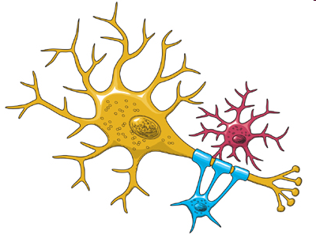
Neurogenesis
Neuron generation occurs rapidly in the developing embryo and fetus
Alcohol exposure during this process affects cell numbers
  Can result in cognitive and behavioral deficits
Notes:
As stated previously, neuron generation (creation/development) occurs very rapidly in the developing embryo and fetus. Through mitosis (cell division), a cell duplicates the chromosomes in its nucleus and creates two identical daughter cells.
The deleterious (harmful) effects of alcohol exposure on this process have been well described in both animal models and models using cultured neurons.
Cell numbers in certain regions of the brain are affected, which might result in cognitive and behavioral deficits.

Slide 19
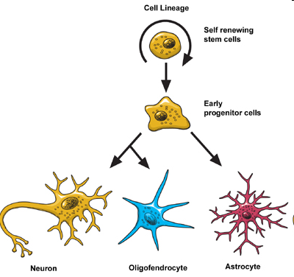
Growth and differentiation
Newly formed neurons undergo maturation or differentiation
Each of these processes is vulnerable to the effects of ethanol exposure
Notes:
Newly formed neurons undergo maturation or differentiation.
Associated with this differentiation is the genetic expression of appropriate neurotransmitters (communication chemicals) for synaptic function, growth, and migration of the processes (neurites) to their respective locations and migration of the cell to its appropriate location (brain nuclei).
Each of these processes is vulnerable to the effects of ethanol exposure depending on when alcohol exposure occurs coincident with the process.
As such, alcohol exposure at any time might affect any one of the processes in various ways.

Slide 20
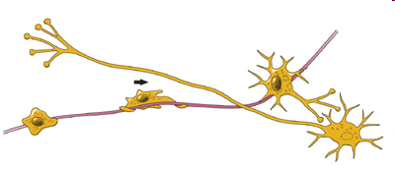
Migration
Cellular migration and migration of the cell
Nerve growth factors
Neurites are guided to their destinations following chemical substrates
Notes:
Cellular migration occurs to form nerve pathways. Neurons follow a pathway to their designated position in the nervous system. This highway consists of supporting cells called glia.
Nerve growth factors facilitate this process. These are a type of protein that is important to the growth, maintenance, and survival of neurons. They are also an important part of development of neurites, which are basically the beginning of the axons or dendrites of a neuron.
(Axons are slender projections from a neuron that usually transmit signals from one neuron to another. Dendrites are slender projections from a neuron that usually receive signals from another neuron. They are called neurites at the early stages of neuron development because it cannot be determined until later whether the projections will be an axon or a dendrite.)
Neurites are guided to their destinations by following chemical signals.

Slide 21
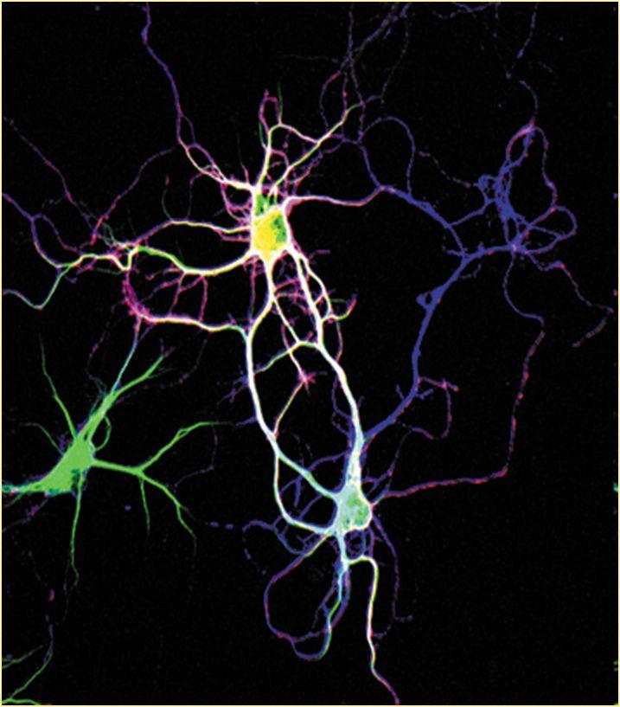
Synaptogenesis
Once at its destination, the neurite must form a synapse
The connection between two nerves allows communication between the nerves
Alcohol exposure during this period may disturb this process
Togashi, Miyoshi, Sakisaka, Takai, &Takeichi, 2006
Notes:
Once arriving at its predetermined destination, the neurite must form a synapse to function normally.
The connection between two nerves, or between a nerve and another cell (such as a muscle or glandular cell) is a chemical link that allows communication between the nerve and the other cell. This is a critical junction at which various components must be present for proper operation.
Alcohol exposure during this period might disturb the various mechanisms on which normal synaptogenesis depends.

Slide 22
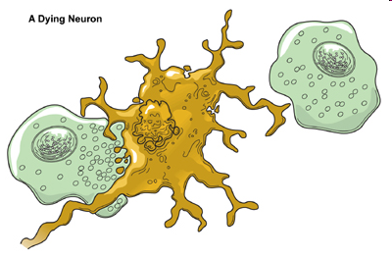
Apoptosis
Programmed cell death
Alcohol exposure may enhance apoptosis
Notes:
More nerves are formed in the brain than are actually needed. This might be to ensure correct synapse formations for critical functions. For example, neurons might be formed and reach their targets. There might, in fact, be twice as many cells reaching those targets.
Only those cells forming a functional synapse on the target will be supported by nerve growth factors. The other neurons reaching that target cell will not be supported and will be discarded by a process of programmed cell death called apoptosis.
Apoptosis also might occur in cells that are needed but are erroneously “activated,” through alcohol or other teratogens, to undergo cell death.
Alcohol exposure, therefore, might enhance apoptosis, resulting in more extensive cell death than what was biologically programmed.

Slide 23
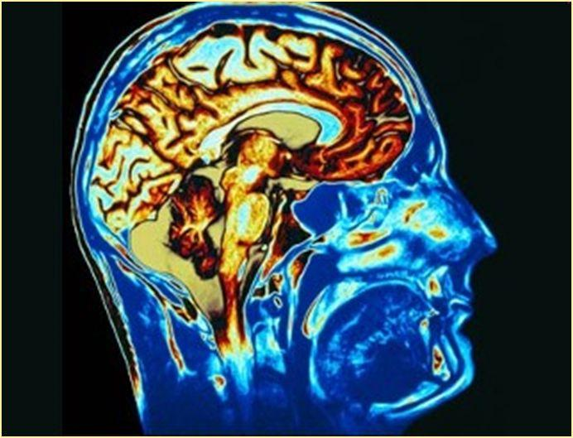
Plasticity
A nerve cell’s ability to grow back and re-establish meaningful connections after it is damaged
Mature neurons are less able to regenerate their function
Prenatal alcohol exposure seems to decrease plasticity
Getty Images
Notes:
When a nerve cell or its process is damaged, such as by trauma, its ability to grow back and re-establish meaningful connections is a function of its plasticity.
Most neurons are “plastic” during development, but when maturation occurs, they are regarded as post-mitotically static, and they become less able to regenerate their function. That is, they are less likely to be able to repair themselves and return to normal function.
Alcohol exposure during development appears to decrease the ability of the nervous system to regenerate.

Slide 24
Biomedical Mechanisms
Notes:
Numerous scientific studies have tried to determine the biomedical mechanisms associated with FAS and FASDs. These studies are associated with the cellular and molecular research that are related to the mechanisms of neural development.
(Biomedical = relating to biology and medicine – biomedicine. Biomedicine = application of principles of biology and physiology to clinical medicine)
(Presenters: Depending on the prior knowledge & skills of the audience, this section can be skipped if necessary. This section may be more appropriate for biomed students/professionals)

Slide 25
Neuromorphological and neurotropic effects
Research has shown that alcohol can affect:
  Cell development
  Cell migration
  Cell processes
Examples:
  Increases cell death
  Alters the growth of dendrites, affecting how the cell functions and communicates
  Disrupts neurogenesis and migration of neurons
Notes:
Neuromorphological birth defects = the study of birth defects associated with the formation of and communication within and between the nervous systems (central & peripheral).
Neurotropic = a toxin that tends to attack the tissues of the nervous system (i.e., nerve cells).
Studies have found that alcohol can have the following effects:
Increases cell death and/or apoptosis either through the alcohol directly affecting the cell or as a result of changes to the cell’s programming.
Alters the growth of dendrites and therefore the neuron’s ability to function & communicate.
Disrupts the process of neuron creation (neurogenesis) and then how those cells migrate to the parts of the brain they are programmed to function in.
Causes a decrease in the synthesis (creation) of proteins, reducing or altering the cell’s ability to function normally.
(Presenters: see pg 11 of competency IV in the curriculum guide for more effects of alcohol on cells and adjust examples to be in line with audience skills & prior knowledge)

Slide 26
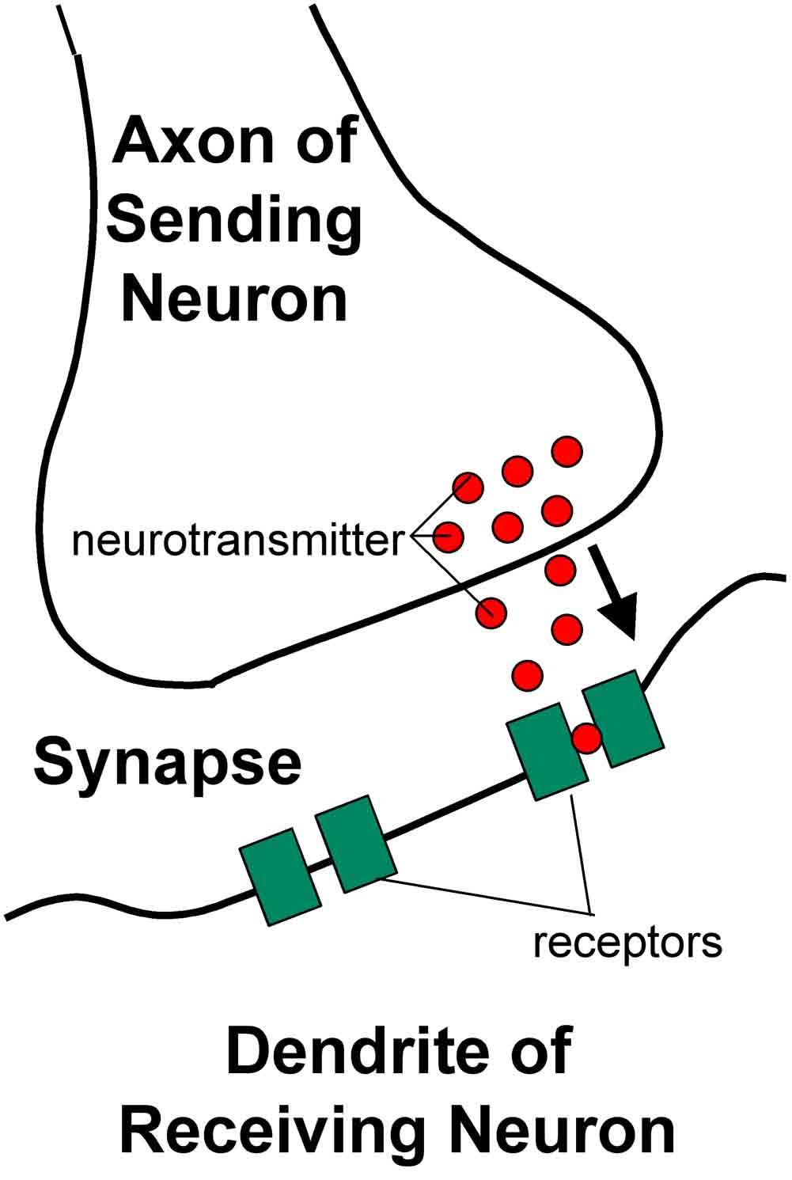
Other biomedical mechanisms
Prenatal alcohol exposure can affect the development of neurotransmitter receptors
  Affects the ability of nerves to function & communicate
Prenatal alcohol exposure may affect the way a cell responds to received signals
Catherine E. Myers. 2006 Memory Loss and the Brain
Notes:
(Presenters: see pg 12 of competency IV in the curriculum guide for more effects of alcohol on cells and adjust examples to be in line with audience skills & prior knowledge)
(Neurotransmitter = a chemical that is released from a neuron. It transmits signals from the neuron across the synapse to the target cell. Basically it helps in the communication between cells.)
(Neurotransmitter receptor = a protein that receives chemical signals (neurotransmitters). Essential to communication between neurons.)
Other scientific research has attempted to determine the effects of prenatal alcohol exposure on the cellular/molecular function that might occur following development.
Examples of alcohol exposure during development on neurotransmitter receptors:
Increased sensitivity (up-regulation) of NMDA (N-methyl D-aspartate) receptors.
Altered GABA (gamma-Aminobutyric acid)-mediated neurotransmission. (GABA helps regulate the reactions of neurons.)
Excess nitric oxide (NO) formation leading to glutamate-mediated cell death.
Specific apoptotic cell dean in NMDA and GABA receptor systems.
Abnormal serotogenic and/or catecholaminergic system development.
Take-home message: Prenatal alcohol exposure can affect the development of neurotransmitter receptors, altering the ability of neurons to function and communicate with other cells.
Effects on Signal Transduction
(signal transduction = the process where a chemical signal/stimulus to a cell is converted into a response by that cell. That is, signal transduction begins with the receptors on the cell receiving the signal and ends with the cell responding in a certain way to that signal.)
Some research has focused on specific transduction events within cells in response to stimulation that might be affected by fetal alcohol exposure.
Effects include:
Altered G-protein transduction systems.
Reduction of adenylate cyclase activity.
Increased protein kinase C phosphorylation.
Increased release of calcium into the cytosol.
Up-regulation of voltage-gated calcium channels.
Take-home message = prenatal alcohol exposure may cause a cell to not respond the way its supposed to when it receives a certain signal.)
Pharmacologically, ethanol is a ‘dirty’ drug. Although classified as a depressant, it might have a variety of molecular effects, rather than on specific effect. FAS might occur because of this variety of effects. That is, there might not be any one molecular rason that alcohol exposure during development results in FAS or an FASD. Rather, it is more likely that FAS or an FASD is a result of the additive or synergistic effects of alcohol on the developing system (i.e., it’s the combined effect of alcohol exposure to the fetus’ developing systems that result in FAS or an FASD).
(Synergy = the coming together of a variety of things to make something happen)

Slide 27
Effects on Neurobehavior
Notes:
Neurobehavior = how the brain affects emotion, behavior, and learning
Prenatal alcohol exposure, because of the way it affects the development of not only the major structures of the brain, but also the individual neurons and other cells, and how those cells function and communicate, may result in problems with emotion (regulating, expressing), behavior (a person’s actions), and learning.

Slide 28
Cognitive and behavioral deficits
Individuals with FAS may have low IQ
Attention, memory, hyperactivity
Learning impairments
  Not just related to academics, also language, visual-spatial skills
Secondary conditions
  Mental health problems
  Disrupted school experiences
  Trouble with the law
  Confinement and/or incarceration
  Inappropriate sexual behavior
  Alcohol or other drug problems
Notes:
As discussed in previous sections, alcohol exposure is associated with a variety of potential structural and functional changes to the developing nervous system. Any single change affects the ability of the cell to function appropriately and correctly communicate or process information essential to the nervous system. Reduced function or efficiency of nerve cells will result in alterations that might be expressed as changes in functions related to thinking, learning, and movement.
However severe or subtle they might be, the effects of alcohol might contribute to intellectual disability or movement disorders as part of the organic (physical) disturbance to the formation and function of the brain and its cellular components.
One study found that the average IQ of 178 individuals diagnosed with FAS was 79 (range 20–120), which is below the general population range of 85–115. Also associated with organic brain dysfunction (dysfunction or abnormal functioning related to the physical structure of the brain or nervous system) are various maladaptive behaviors and symptoms of people with FAS and other FASDs.
Behavioral deficits might include attention deficits, memory problems, and hyperactivity. Less common are a lack of awareness of what is happening in one’s immediate surroundings, peculiar mannerisms or habits, preoccupations, or self-injurious behavior.
Memory and learning impairments are common features of FAS and FASDs, although the specific deficits experienced by individuals with these conditions vary widely. Some investigators have linked these deficits to alterations in brain structure, at least for those impairments that might be ascribed to an area or areas of the brain related to that respective function (e.g., language).
Verbal learning: Children exposed to alcohol prenatally exhibit a variety of problems with language and memory. Findings indicate that FAS-related learning problems occur during the initial stages of memory formation (i.e., encoding).
Visual-spatial learning: Children with FAS perform poorly on tasks that involve learning spatial relationships among objects.
Attention: Attention problems are a hallmark of prenatal alcohol exposure.
Children exposed to alcohol prenatally are able to focus and maintain attention, but they display difficulty in shifting attention from one task to another (i.e., set shifting).
Reaction time: How quickly the brain processes information is part of individual differences in intelligence measures.
Exposure to alcohol during pregnancy has been associated with slower, less efficient information processing, as measured by longer reaction times in both school-age children and infants.
Executive functions: Children exposed to alcohol prenatally respond poorly when asked to switch back and forth from identifying classes of objects (e.g., animals versus types of furniture).
Children with FAS also have difficulty abandoning ineffective strategies when approaching problem-solving tasks. These behaviors might be expressed through secondary disabilities, six of which have been recognized and assessed: (a) mental health problems, (b) disrupted school experiences, (c) trouble with the law, (d) confinement and/or incarceration, (e) inappropriate sexual behavior, and (f) alcohol or other drug problems.

Slide 29

Review
Alcohol metabolism and pharmacology
Birth defects associated with alcohol use
Alcohol-induced injuries on developing nervous system
Cellular response to alcohol exposure
Neurobehavioral effects
Notes:
Review & ask for additional questions & comments.

Slide 30


Arctic FASD Regional Training Center www.uaa.alaska.edu/arcticfasdrtc arcticfasdrtc@uaa.alaska.edu
907.786.6381
The Arctic FASD Regional Training Center is a project of the UAA Center for Behavioral Health Research & Services.
Funding for this project is provided by CDC Cooperative Agreement #U84DD000886-01.

