Slide 1


Fetal Alcohol Spectrum Disorders:
Competency III –
Models of Addiction
The Arctic FASD Regional Training Center is a project of the
UAA Center for Behavioral Health Research & Services.
Funding for this project is provided by CDC Cooperative Agreement #U84DD000886-01.
Notes:
This PowerPoint was created by the University of Alaska Anchorage Center for Behavioral Health Research & Services’ CDC-funded Arctic FASD Regional Training Center in 2010 and revised in 2013. The content is based primarily on materials and resources available in CDC’s Fetal Alcohol Spectrum Disorders Competency-Based Curriculum Development Guide for Medical and Allied Health Education and Practice (2009).
This guide was revised in 2015 and is available from www.frfasd.org/Comp_Guide.html.
If you are using elements of this PowerPoint in another presentation, please credit the Arctic FASD Regional Training Center and the 2009 Fetal Alcohol Spectrum Disorders Competency-Based Curriculum Development Guide for Medical and Allied Health Education and Practice.
Questions about this PowerPoint or its contents should be addressed to the Center for Behavioral Health Research & Services at the University of Alaska Anchorage – www.uaa.alaska.edu.
Funding was provided by the Centers for Disease Control and Prevention (CDC) to the Center for Behavioral Health Research and Services (CBHRS) at the University of Alaska Anchorage. The goal of the Arctic FASD Regional Training Center was to increase awareness about FASD among health and allied health students and professionals.
The CDC has identified seven core competencies that enable professionals to more effectively prevent, identify, and treat FASDs.
This presentation covers competency three, models of addiction.

Slide 2

Road Map for Presentation
Models of alcohol use
Categories of alcohol use
Stages of alcohol use in women
Stages of change in alcohol use
Coexisting disorders
Alcohol dependent families
Notes:
Road Map for Presentation
In today’s workshop we’ll first review the past and current models of alcohol use, then move on to describing the categories of alcohol use and the stages of alcohol use in women, including the medical criteria for alcohol use disorders and the stages of use, dependence, and addiction. After that we’ll talk about the stages of change in alcohol use, alcohol use and co-occurring psychiatric disorders, and finally the characteristics of alcohol-dependent families, including the role of genetics and the family factors that might contribute to alcohol use.
By the end of this workshop you will be able to:
Explain past and current models of alcohol use.
Describe the categories of alcohol use in women.
Describe the stages of alcohol use, dependence, and addiction.
Explain the stages of change in alcohol use.
Address co-occurring psychiatric disorders related to alcohol use.
Recognize characteristics of alcohol-dependent families.

Slide 3
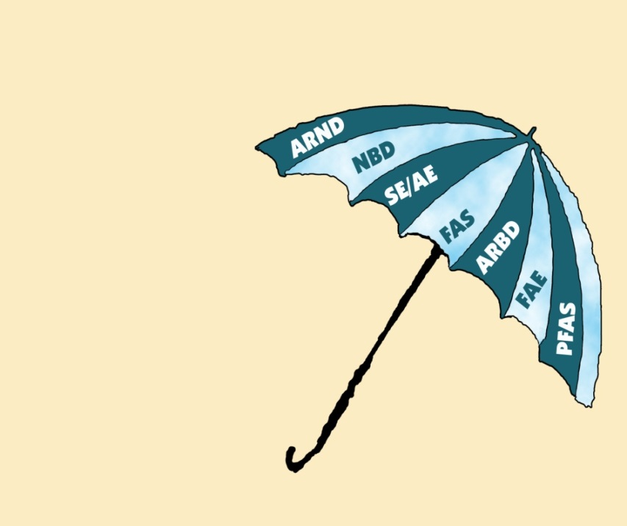
Terminology of FASD
FASD is an umbrella term
Describes range of effects caused by prenatal alcohol exposure
FAS is a subset of FASD
Fetal alcohol spectrum disorders
Image source: State of Alaska Division of Health and Social Services’ FASD 101: Insights into Fetal Alcohol Spectrum Disorders.
Notes:
Presenters: This slide may be included or omitted depending on how familiar the participants are with FASD.
Terminology
Before we move on with our discussion, we’ll review the terminology used in discussing FASD. Since the 1970s, there have been different researchers have observed the effects of prenatal exposure to alcohol and developed a variety of names for these effects, most of which are known by an acronym. The acronyms on the umbrella have all been used at some point to describe the effects of prenatal alcohol exposure – and many are still in use today.
FASD is an umbrella term
Fetal alcohol spectrum disorders (abbreviated to FASD or sometimes FASDs) is an umbrella term used to describe the range of effects that can occur in an individual whose mother drank alcohol during pregnancy.
These effects can include physical, mental, behavioral, and/or learning disabilities. These effects are life-long. Each person who is affected by pre-natal alcohol exposure is affected differently, so it’s important to look at the individual, not the term.
These terms include alcohol-related neurodevelopmental disorder, neurobehavioral disorder (alcohol exposed), static encephalopathy/alcohol exposed, fetal alcohol syndrome, alcohol related birth defects, fetal alcohol effects, partial-fetal alcohol syndrome.
Fetal alcohol syndrome, or FAS, is a subset of FASD. It is a medical diagnosis that involves a specific pattern of findings associated with in utero exposure to alcohol.
Please keep in mind that it is not the only possible outcome of prenatal alcohol exposure, nor does it mean that individuals with a diagnosis of FAS have a greater disability than others who are prenatally exposed to alcohol. A diagnosis of FAS simply means that the individual has more outward or physical signs of the disability, in addition to nervous system problems. In fact not having a diagnosis of FAS may in fact cause more problems for an individual through their lifetime.

Slide 4
Past and current models of alcohol use
Notes:
Epidemiological studies have shown that there is a higher risk for an alcohol exposed pregnancy among women who experience alcohol abuse. Because of this, it is important for health and allied health providers to be familiar with models of addiction and how these can relate to primary FASD prevention strategies.
(That is, because women who experience alcohol abuse are at higher risk to drink alcohol during pregnancy (having an alcohol exposed pregnancy), it’s important that health and allied health providers are familiar with how addiction has been and is currently understood. An understanding of addiction can help providers and women who experience alcohol abuse prevent alcohol exposed pregnancies and therefore FASDs.)

Slide 5
Evolving Models of Addiction
Definitions of alcohol-related problems change through time
Conceptualization of a problem influences treatment strategy
Different models may exist simultaneously
Notes:
Alcohol-related problems have been defined in many ways through history, depending on the political and social climate.
How we conceptualize a problem greatly influences how we treat it. While the most accepted model in the science community is a biomedical model, other models still have many proponents and provide alternative perspectives about how people think about and address alcohol issues. Some models were more prevalent historically, and some are still prevalent today. It should be noted that all of these models that we will discuss might still be used by some professionals today.
(Epidemiology = the study of patterns of health and illness in a population; helps identify risk factors for disease and the best approaches for prevention and treatment of diseases)
(FASD = fetal alcohol spectrum disorders, the range of cognitive, behavioral and other effects an individual may experience as a result of prenatal (prior to birth) alcohol exposure.)

Slide 6
Models of Addiction
Moral Model
Sociocultural Model
Addiction is an individual choice
Lack of moral strength
Treatment
  Recognition of sinfulness
  Ask for help
  Accept punishment from moral authorities
  Accepted back into society
Addiction is facilitated by society
Social norms and marginalization
Treatment
  Education
  Economic opportunity
  Reintegration into society
Notes:
Moral Model
One of the first models of alcoholism, the moral model, emphasized a personal choice as a cause of the problem. In this model, someone who is alcohol dependent (typically referred to as alcoholic in this model) chooses whether to drink or to abstain.
Proponents of the moral model see the alcoholic individual as unable or unwilling to “do the right thing” and they see the “alcoholic” as making choices in violation of societal norms and morals. Health care professionals and families who adhere to this model believe that the person doesn’t have the moral strength to resist alcohol’s temptation.
Treatment consists of the individual’s recognizing the “sinfulness” of his or her state, asking for help, accepting punishment from the moral authorities and, once forgiven, being allowed back into society. No treatment, per se, is prescribed in this model. Punishment of the alcoholic behavior is important. The sole blame for alcoholism is on the alcohol-dependent individual.
Sociocultural models
A number of similar models promote the belief that alcohol (and drug) abuse is facilitated by society. Influencing factors include a lack of economic opportunity and positive role models in some geographic regions or among some groups of people.
Additionally, in this model, social norms marginalize people who use drugs and abuse alcohol, and such marginalization leads to alcohol and drug peer networks that then provide social reinforcement. Treatment involves education, economic opportunity, and reintegration back into society.
(Model = a way of looking at something; a construct for understanding addiction, what causes it, and how people who experience addiction should be treated. People may accept elements from several different models in their own understanding of addictions.)

Slide 7
Models of Addiction
Psychological Model
Addictive Disease Models
Addiction promoted through observation of others
Lack of coping skills
Treatment
  Learning positive coping skills
  Reducing stressors
  Resolving emotion problems
Addiction is incurable disease
  Biology, personality, and spiritual dysfunction
Denial and loss of control
Treatment
  Abstinence
  Inpatient or outpatient treatment
  AA approach
Notes:
Psychological Models
A variety of related models are based on the idea that heavy drinking is promoted from observing others. Children, therefore, learn that drinking is an effective means of dealing with stress or enjoying social situations. Drinking is viewed as a way to numb emotional pain or achieve pleasure.
Proponents of this model are likely to view alcohol and other substance use problems as indicative of a lack of other coping skills to deal with stress. Treatment involves learning positive coping skills, reducing stressors, and resolving other psychological and emotional problems.
The conditioning model, a cousin of the psychological models, purports that people learn to drink because it is reinforced. In the conditioning model, treatment relies on classical conditioning (usually aversive therapies) in which drinking is punished and abstaining is rewarded.
Addictive Disease Model
This model is sometimes confused with the biomedical model.
The addictive disease model promotes the idea that addiction is a primary disease that is progressive and incurable. The disease exists because of biological, personality, and spiritual dysfunction. A loss of control over alcohol and denial that one has an alcohol problem are indicators of the disease. Abstinence is the necessary first step for treatment.
The Alcoholics Anonymous approach to treatment is based on this model. Other options include outpatient and residential detoxification.
(Primary disease = one that arises (comes into being) spontaneously and is not linked to or caused by a previous disease, injury or event.)

Slide 8
Models of Addiction
Biomedical Model
Recovery
Addiction is a brain disorder
  Genetics and environment
Alcohol abused because it stimulates brain’s reward pathway
Treatment
  Drug substitution
  Medication for symptoms
  Brief psychotherapy
Addiction is multifaceted
  Bio-psycho-social origin
  Many different programs
Recovery is a unique, individual and personal journey
Recovery Principles
  Hope, empowerment, inclusion
  Secure base
  Self
  Supportive relationships
  Coping strategies
  Purpose and meaning
Notes:
Biomedical
This model is most widely supported by the scientific literature.
It is based on the idea that alcohol dependence is a brain disorder, related to dysfunction of neurotransmitters (most likely a mixture of dopamine, serotonin, GABA, and glutamate). There is both a genetic and environmental basis for dependency. Alcohol (and other drugs) is abused because it stimulates the reward pathway in the brain.
Proponents of this approach might think abstinence is advisable but not see it as necessary for all people with dependency, favoring instead a harm-reduction approach, drug substitution, craving reduction medication, and brief psychotherapy, such as motivational interviewing and cognitive behavioral approaches.
(Dysfunction = disturbance in how an organ or body part functions or failure to function (work) in a way that is expected or complete; something that differs from the normal or typical way)
(neurotransmitter = a chemical that is required for nerve cells to communicate with each other and with other cells)
Recovery
While not a true model, per se, Recovery is a way of understanding, treating, and supporting the individual who experiences addiction. Rather than accepting one particular etiology, the Recovery concept recognizes that addiction is multifaceted and the result of the confluence of biological, social, and psychological factors. Therefore recovery from addiction is a unique, individualized, and personal journey.
The principles of recovery include:
Hope, empowerment, and inclusion in society
Having a secure and stable base
Understanding the self
Participating in supportive relationships
Developing personal coping strategies
Finding or developing purpose and meaning in one’s life

Slide 9
Treatment Programs
Most contemporary addiction professionals and treatment centers do not fit precisely with any one of the above models.
Determining which modality of treatment is best is best left to the family and the individual needing treatment.
Notes:
However, most professionals and treatment centers who work with individuals who experience addiction do not adhere to one particular model. Instead, elements from each of these models may influence the view and treatment of addiction.
In determining which modality of treatment is best, it is better to leave the decision to the individual and family involved.

Slide 10
Models of Addiction
Alcoholism
Alcoholism is a primary, chronic disease with genetic, psychosocial, and environmental factors influencing its development and manifestations.
The disease is often progressive and fatal.
It is characterized by continuous or periodic impaired control over drinking, preoccupation with the drug alcohol, use of alcohol despite adverse consequences, and distortions in thinking, most notably denial.
Notes:
Definition of Alcoholism
Alcoholism is a primary, chronic disease with genetic, psychosocial, and environmental factors influencing its development and manifestations. The disease is often progressive and fatal. It is characterized by continuous or periodic impaired control over drinking, preoccupation with the drug alcohol, use of alcohol despite adverse consequences, and distortions in thinking, most notably denial.
Primary refers to the nature of alcoholism as a disease entity in addition to and separate from other pathophysiologic states that may be associated with it, and primary suggests that alcoholism, as an addiction, is not a symptom of an underlying disease state.
(Primary disease = one that arises (comes into being) spontaneously and is not linked to or caused by a previous disease, injury or event.)
Disease means an involuntary disability. It represents the sum of the abnormal phenomena displayed by a group of individuals. These phenomena are associated with a specified common set of characteristics by which these individuals differ from the norm, and which places them at a disadvantage.
(disease = involuntary, meaning that the person did not decide to develop an addiction to alcohol; there is a common set of symptoms or criteria that all individuals who experience an addiction show or have, and this set of symptoms or criteria; these individuals are at a disadvantage because of this)
Often progressive and fatal means the disease persists over time and that physical, emotional, and social changes are often cumulative and may progress as drinking continues. Alcoholism causes premature death through overdose; through organic complications involving the brain, liver, heart, and many other organs; and by contributing to suicide, homicide, motor vehicle crashes, and other traumatic events.
(There are physical, emotional, and social impacts to this disease; these changes or impacts build on each other over time. Premature death can be caused through an overdose of alcohol or through the damage that is done over time to the brain, liver, heart of other organs.)
Impaired control means the inability to limit alcohol use or to consistently limit on any drinking occasion the duration of the episode, the quantity consumed, and/or the behavioral consequences of drinking.
Preoccupation in association with alcohol use indicates excessive, focused attention given to the drug, its effects, and/or its use. The relative value thus assigned to alcohol by the individual often leads to a diversion of energies away from important life events.
Adverse consequences are alcohol-related problems or impairments in such areas as physical health, psychological functioning, interpersonal functioning, occupational functioning, and legal, financial, or spiritual problems. (This means that individuals who experience alcoholism may experience health problems as a result of their drinking, social or relationship problems, issues with their employment (they might lose their job, for example), and other legal, money, or spiritual problems.)
Denial is used here not only in the psychoanalytic sense of a single psychological defense mechanism disavowing the significance of events, but more broadly to include a range of psychological maneuvers designed to reduce awareness of the fact that alcohol use is the cause of an individual’s problems. Denial becomes an integral part of the disease and a major obstacle to recovery. (That is, denial in this context is not just about downplaying that any of the problems in terms of employment, social relationships, etc. are related to drinking, but also to how the person goes about downplaying this. Denial is therefore a symptom of the disease.)

Slide 11

Models of Addiction
Addictive Disease Process
Craving and compulsion
Loss of control
Continued use despite adverse consequences
Notes:
Presenters note: Refer participants to handout on the Addictive Disease Process if you handed it out.
Craving and Compulsion
Mildest form of craving is vivid dreams about the pleasures of use, more pronounced craving—thinking about how nice the drug was, preoccupation on planning the next opportunity to use the drug (unable to stay in the now), actual physical hunger for the drug (withdrawal).
Loss of Control
Amount: becomes increasingly less able to predict the amount of drug one will use once started, has difficulty “saving” some of the drug for later use, as disease progresses, larger amounts of drug are needed to satisfy increasing desire.
Time and place: Finds it difficult to confine use to times and place.
Duration of episode: May use drug until it’s all gone, which prevents other activities, i.e., missing time from work and neglecting obligations, family and/or financial.
Continued Use Despite Adverse Consequences
May affect areas of life: legal, family, health, occupational, sexual, social.
Drug use patterns: variety of drugs, alternating drug of choice, over lifetime, progression towards more severe involvement.
Since the addictive disease process is both chronic and progressive, one assumes that it will continue to grow steadily if it is not arrested.
Violent behavior is not part of the addictive disease process.

Slide 12
Categories of alcohol use

Slide 13

Alcohol Use by Women
More than 50% of women 18-44 report some alcohol use
  12% report binge drinking
12% of pregnant women report consuming alcohol during pregnancy
2%-4% pregnant women report binge drinking
Alcoholic drink containers may hold multiple standard drinks
Notes:
In the United States, more than half (54%) of all women of childbearing age (18–44 years of age) report some alcohol use, and one in eight (12%) reports binge drinking in the past 30 days.
Although most women reduce alcohol consumption after learning that they are pregnant, in the United States, 12% of pregnant women report consuming any alcohol, and 2% report binge drinking in the past 30 days.
(Centers for Disease Control and Prevention. (1995). Sociodemographic and behavioral characteristics associated with alcohol consumption during pregnancy—United States, 1988. Morbidity and Mortality Weekly Report, 44(13), 261–264; Centers for Disease Control and Prevention (2009) Alcohol use among pregnant and nonpregnant women of childbearing age – United States, 1991-2005. Morbidity and Mortality Weekly Report 558(19):529-532 (May 22, 2009) www.cdc.gov/mmwr/preview/mmwrhtml/mm5819a4.htm?s_cid=mm5819a4_e)
The risk of a woman giving birth to a child with an FASDs depends on multiple factors, such as the pattern, volume, timing, and duration of alcohol use.
Additional maternal risk factors might include age, race, ethnicity, socioeconomic status, nutrition, alcohol metabolism, genetic sensitivity to alcohol, and possible interactions among these factors.
(Tsai, J., Floyd, R. L., Green, P. P., & Boyle, C. A. (2007). Patterns and average volume of alcohol use among women of childbearing age. Maternal and Child Health Journal, 11(5), 437–445.)
Presenters note 1: This is a place for the serving size demonstration if appropriate for the audience.
Presenters note 2: Refer participants to handout that shows approximate standard drink equivalents of common alcoholic drinks.
Standard drink size
Traditionally, all drinks have been considered equivalent in terms of the amount of absolute alcohol.
A standard drink contains about 14 grams (about 0.6 fluid ounces) of pure alcohol, which is equivalent to one 12-ounce beer or wine cooler, one 5-ounce glass of wine, or 1.50 ounces of 80-proof distilled spirits.
However, people buy many alcoholic drinks in containers that hold multiple standard drinks.
For example, malt liquor is often sold in 16-, 22-, or 40-ounce containers that hold between two and five standard drinks, and table wine is typically sold in 25-ounce (750 ml.) bottles that hold five standard drinks.

Slide 14
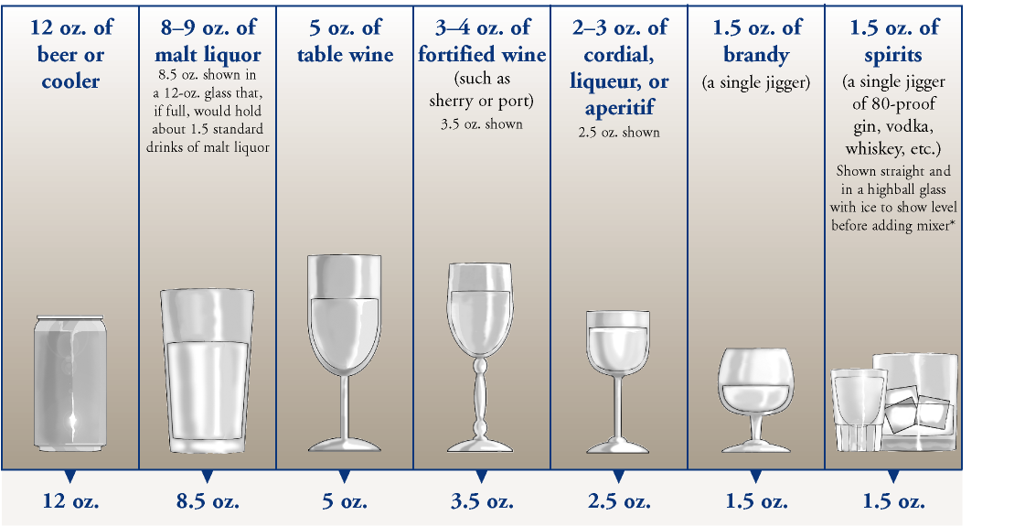
A Standard Drink
Notes:
To evaluate a rough equivalency of alcoholic beverages, it is important to consider the concentration of alcohol used in the beverage as well as the volume.
For example, NIAAA (National Institute on Alcohol Abuse and Alcoholism) guidelines (2005) use the following beverage types and volumes as rough equivalencies for standard drinks:
One 12-ounce (355 ml) can or bottle of beer
One 5-ounce glass of wine
One 12-ounce wine cooler
One 4-ounce glass of sherry, liqueur or aperitif
One 1.5 ounce ‘shot’ of liquor (distilled alcohol)
The quantity of alcohol in each of the drinks on this slide is approximately equal.
This is easily determined by estimating the percent alcohol used in the drink (e.g., beer = 3%–5% by volume).
Simple calculations indicate that one can of beer contains approximately 11 ml of alcohol (355 ml x 0.03), and within the 11 ml there is approximately 8.7 g of alcohol (11 ml x 0.789 g/ml).
Each of the drinks on this slide contains 8–10 grams of alcohol (roughly).
The exception is the “shot” of spirits.
While 1–1.5 ounces is commonly used in a “mixed drink,” the percent alcohol contained within the shot is variable with some spirits being 30% alcohol, and other spirits being 80% or more.
Although the high end of 10 grams of alcohol in one mixed drink would be a reasonable estimate, one must be aware that it could be greater depending on the spirits used in the drink.

Slide 15
Categories of Alcohol Use
Abstainers
Low-risk drinkers
At-risk drinkers
Problem drinkers
Alcohol dependent drinkers
Notes:
Abstainers
Do not consume alcohol at all or less than 1 standard drink per month.
Low-risk drinkers
Consume 1–2 standard drinks per day, three or fewer times per week.
Their use of alcohol does not affect their health and it does not result in negative consequences.
They do not use alcohol before driving, when pregnant, when breastfeeding, or with certain medications.
At-risk drinkers
Consume 7–21 standard drink per week; consume more than 3–4 standard drinks per occasion, or drink in high-risk situations.
Problem drinkers
Consume more than 21 standard drinks per week and might experience negative consequences from such drinking (behavioral, family, medical, mental health, employment, social, legal, etc.).
Alcohol-dependent drinkers
Cannot stop drinking once they start.
They experience repeated negative consequences from such drinking (behavioral, family, medical, mental health, employment, social, legal, etc.).
Heavy drinking leads to a physical need for alcohol.

Slide 16
Categories of Alcohol Use
Alcohol Abuse Criteria
Failure to fulfill major role obligations because of drinking
Recurrent drinking in hazardous situations
Recurrent legal problems related to alcohol
Continued use despite recurrent social and interpersonal problems
Notes:
Alcohol abuse criteria
One or more of the following occurring at any time in the same 12-month period
Failure to fulfill major role obligations at work, school, or home because of recurrent drinking
Screening questions: Have you had a period when your drinking—or being sick from drinking—often interfered with taking care of your home or family?
Caused job troubles?
School problems?
Recurrent drinking in hazardous situations
Screening questions: Have you more than once driven a car or other vehicle while you were drinking?
Have you gotten into situations while drinking or after drinking that increased your chances of getting hurt—like swimming, using machinery, or walking in a dangerous area or around heavy traffic?
Recurrent legal problems related to alcohol
Screening questions: Have you gotten arrested, been held at a police station, or had any other legal problems because of your drinking?
Continued use despite recurrent interpersonal or social problems
Screening questions: Have you continued to drink even though you knew it was causing you trouble with your family and friends?
Have you gotten into physical fights while drinking or right after drinking?

Slide 17
Categories of Alcohol Use
Alcohol Dependence Criteria
Tolerance
Withdrawal syndrome
Impaired control
Drank more or longer than intended
Neglect of activities
Time spent related to drinking or recovering
Continued use despite consequences
Notes:
Alcohol dependence criteria
Three or more of the following, occurring at any time in the same 12-month period
Tolerance
Screening questions: Have you found that you have to drink much more than you once did to get the effect you want?
Withdrawal syndrome or drinking to relieve withdrawal
Screening questions: When the effects of alcohol are wearing off, have you had trouble sleeping? Found yourself shaking? Nervous? Nauseated? Restless? Sweating or with your heart beating fast?
Impaired control
Screening questions: Have you more than once wanted to stop or cut down on your drinking? Or tried more than once to stop or cut down but found you couldn’t?
Drank more or longer than intended
Screening questions: Have you had times when you ended up drinking more than you meant to? Or kept on drinking for longer than you intended?
Neglect of activities
Screening questions: In order to drink, have you given up or cut down on activities that were important or interesting to you or gave you pleasure?
Time spent related to drinking or recovering
Screening questions: Have you had a period when you spent a lot of time drinking? Or being sick or getting over the bad after-effects of drinking?
Continued use despite recurrent psychological or physical problems
Screening questions: Have you continued to drink even though you knew it was making you feel depressed or anxious? Or causing a health problem or making one worse? Or after having a blackout?

Slide 18
Stages of Alcohol use, dependence, and addiction

Slide 19
Medical Criteria for Alcohol Use Disorders
AMA recognized alcoholism as a disease in 1956
90% of adults in the US have had some experience with alcohol
Alcohol-related adverse life events
  60% of men
  30% of women
Notes:
The American Medical Association recognized alcoholism as a disease in 1956.
According to the Diagnostic and Statistical Manual of Mental Disorders (DSM), as many as 90% of the adults in the United States have had some experience with alcohol. Of these adults, 60% of men and 30% of women have had one or more “alcohol-related adverse life event”, such as missing work due to a hangover or driving while intoxicated.
On the following slide are the DSM-IV criteria for alcohol-related disorders. In addition to these criteria, generic aspects of substance abuse and dependence can be found in the DSM-IV criteria for those specific issues.

Slide 20
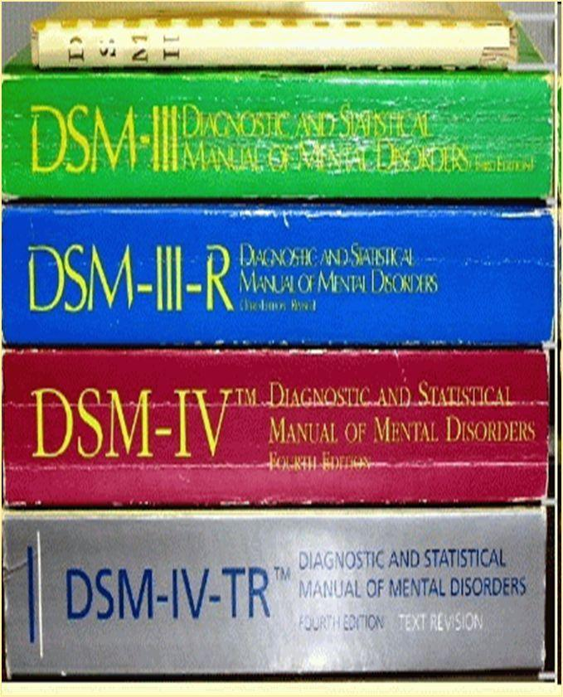
DSM-IV Codes for Alcohol Use
303.90 Alcohol Dependence
305.00 Alcohol Abuse
303.00 Alcohol Intoxication
291.81 Alcohol Withdrawal
Notes:
Alcohol Dependence
Individuals with alcohol dependence continue to consume alcohol, regardless of adverse consequences, usually to avoid or relieve the withdrawal symptoms. Approximately 5% of the individuals with alcohol dependence will experience true alcohol withdrawal and its complications. A primary mental disorder should be considered when symptoms persist.
Alcohol Abuse
When individuals abuse alcohol, many facets of their lives can be affected. They might experience problems in school or with their job performance; neglect the care of their family; put themselves in hazardous situations, such as driving while intoxicated or using machinery while drunk; and face legal problems as a result of their continued drinking. If an individual experiences tolerance, withdrawal, or compulsive behavior as well, one should consider a diagnosis of alcohol dependence.
Alcohol Intoxication
Here, the essential feature is the presence of “significantly maladaptive behavioral or psychological changes…” (APA, 2000, p. 196) that develop during, or shortly after, the use of alcohol. Instances of sexually inappropriate behavior, impaired judgment, or social functioning also are evident. See Table 3.6 for full diagnostic criteria. Evidence of use is usually obtained by the smell of alcohol on the person’s breath, doing a blood and urine toxicology analysis, and taking a history of use.
Alcohol Withdrawal
Here, the essential feature is withdrawal symptoms that develop after one stops heavy and prolonged alcohol use. Table 3.7 presents the full criteria. If hallucinations or illusions are also observed, one can specify “with perceptual disturbances.”
Symptoms usually are relieved by the consumption of alcohol, or any other “brain depressant.” The symptoms are evident usually within 4–12 hours of cessation of alcohol use, but can last for days. Because of the short half-life of alcohol, withdrawal usually peaks by day 2 and will be markedly improved by the fourth or fifth day. After initial withdrawal, however, some physiological symptoms, such as insomnia and anxiety, can last for months. Dramatic symptoms, such as delirium, usually occur in only 5% of individuals with alcohol withdrawal.
It should be noted that in addition to these criteria, generic aspects of substance abuse and dependence can be found in the DSM-IV criteria for those specific issues – see Table 3.5 of the handout.

Slide 21
Stages of Use
Tolerance
Physical dependency
Major organ change
Notes:
This slide presents the pattern of symptoms and progression of alcohol abuse and addiction.
Tolerance
Tolerance is the ability to drink without becoming intoxicated. Alcohol tolerance usually indicates the presence of alcoholism, or eventually becoming alcoholic—although not everyone with high tolerance will become an alcoholic.
It represents the physical adaptation to the intoxicating properties of alcohol. The development of alcohol tolerance has relatively nothing to do with a person’s weight. (That is, a larger or heavier person is no more likely to experience alcohol tolerance than a smaller or lighter person.) Tolerance progressively increases in that it takes more and more alcohol to give the same result.
In this stage, the use of alcohol usually is socially motivated, and the individual seeks psychological relief by drinking. The “advantage” of tolerance is that it allows the alcoholic to hide the extent of his or her drinking after the appearance of the second stage.
Physical dependency
Physical dependence on alcohol motivates the large bulk of alcoholic drinking. Once withdrawal begins, the alcoholic drinks more to alleviate or eliminate the symptoms. When one drinks continually, for no reason other than to drink, it is the physical dependency, and the last drink has “worn off.” In this stage, an individual might experience blackouts, sneak drinks, gulp down alcohol, and feel guilty about drinking.
Major organ change
Major organ change is seen when alcohol has done measurable damage to the body. It can be an enlarged liver, kidney and pancreas problems, and a whole range of alcohol-related health problems. The effects of alcohol on organs are the most debilitating of any substance. Physical damage plays a key role in alcoholic behavior and in the progression of alcoholism.
Presenter note: Refer participants to the handout of table 3.8 for symptoms associated with the various stages of use.

Slide 22
Treatment for Alcohol Use
Treatment depends on stage of use
  Alcoholics Anonymous (12-step program)
  Cognitive-Behavioral Therapy (CBT)
  Motivational Enhancement Therapy (MET)
  Pharmacotherapy (medication)
Alcohol dependence treatment
  Withdrawal and detoxification
  Intervention to maintain abstinence
Long lasting effects and relapse
  Neurobiologic effects and cravings
  Relapse triggers (stress, relationship problems, etc.)
Notes:
Treatment
Many options for treatment exist, depending on the stage of the alcohol use. Some examples include:
Alcoholics Anonymous and 12-step facilitation therapy —12 steps to work through during recovery.
Cognitive-behavior therapy —teaches individuals, through role-play and rehearsal, to recognize and cope with situations for relapse, and how to cope with cravings.
Motivational enhancement therapy (MET) —motivates patients to use their own resources to change their behavior. This is considered brief intervention and works best with social drinkers.
Pharmacotherapy —use of anticraving medications (e.g., acamprosate and naltrexone), aversive medications (e.g., disulfiram) and medications to treat the co-morbidities (e.g., Prozac).
Other compounds, currently approved for other medical issues, are being tested in clinical trials and have so far shown some efficacy as treatment for alcohol dependence. Further outcomes are pending.
Alcohol dependence
Alcohol dependence is usually treated through withdrawal and detoxification, followed by further interventions to maintain abstinence.
Withdrawal and detoxification
Severity of withdrawal symptoms increases with each withdrawal episode. Severe withdrawal occurs in 2%–5% of all heavy drinkers and chronic alcoholics. It could last for 3–7 days. Death, which occurs in less than 1%, occurs when there is cardiovascular collapse or concurrent infection.
The use of benzodiazepines and phenobarbital reduces the risk of seizures when individuals are medically withdrawn. Individuals are usually admitted to a hospital or treatment center for detoxification.
Long lasting effects and relapse
Long-lasting neurobiologic effects contribute to the persistence of the craving. Relapse can be triggered at any stage of the recovery by internal or external factors.
Internal factors: genetic predisposition, feeling stressed or depressed, co-existing psychiatric disorders.
External factors: social circle (being around others who are drinking alcohol), attending events where alcohol is served, problems with a relationship (e.g. spouse), losing employment.
Thus, health care providers must help the individual understand, anticipate, and prevent relapse.

Slide 23
Stages of change and alcohol use

Slide 24
Stages of Change
Pre-Contemplation
Contemplation
Preparation
Action
Maintenance/Relapse
Notes:
Stages of change in alcohol use
The stages of change model is an outgrowth of the smoking cessation research. Behavior change is not a single, discrete event. Few people have an epiphany event that readily changes their behavior. Behavior change is seen as a process, with identifiable stages. One can take action at any point in the process to assist in change. This model shows that a person’s behavior changes gradually, with the individual moving from an uninterested/unaware state to deciding to change to making the necessary actions to maintain their new behavior.
Relapses often occur and are part of the process, which can sometimes be cyclic: the individual may cycle back into one of the earlier stages. It is important for the individual and their support network to understand that this is to be expected. The stages of change:
Precontemplation
In this stage, the woman does not even consider changing. She is still in denial of her drinking problem and will probably not seek advice. Typically, someone else perceives the alcohol problem in the woman; the woman herself does not. She will likely resist suggestions to change in this stage.
The goal at this stage is that the woman will begin to think about change. Other models that could be helpful at this stage include motivational interviewing, Locus of Control, and Health Belief Model (Glanz, K., Rimer, B. K., & Viswanath, K. (Eds.). (2008). Health behavior and health education: Theory, research, and practice (4th ed.). San Francisco: Jossey-Bass Publishers.)
Contemplation
Here the woman has some awareness of her drinking problem but might be ambivalent about changing. She might reject change because she will need to give up enjoyable behavior. She might feel more of a sense of loss than perceived gain. Here, the woman needs to assess barriers to change (time, expense, hassle, fear, “I know I should stop drinking but…”) as well as the beneficial results of the change.
The goal here is that the woman will examine the benefits and barriers to change. Successful treatment models for this stage include motivational interviewing/person-centered approach, positive reinforcement, asking open-ended questions, and goal setting.
Preparation
Here the woman is ready to change and prepares to make a specific change. Changes might start small, growing as her determination to change increases. This is a window of opportunity when the woman has resolved her ambivalence enough to make the change.
In this stage, the intervention must assist the woman in matching appropriate and effective strategies. Set specific goals, steps to the goals and resources that will be needed.

Slide 25
Stages of Change
Precontemplation
Contemplation
Preparation
Action
Maintenance/Relapse
Notes:
Action
Now the woman is ready to engage in new behavior that will bring about the elimination of her alcohol use. Any action taken should be praised because it demonstrates a desire for and effort to change.
In this stage, intervention should assist the woman in looking at her addiction and identifying coping strategies to change, replace, or avoid triggers that lead to alcohol use. Other treatments include cognitive-behavioral therapies and a 12-step program.
Maintenance/Relapse
Here, the woman tries to sustain changes accomplished in the previous stage. This stage, obviously, is the hardest, because it involves incorporating the changes “over the long haul.” Discouragement over occasional slips might stop progress, and the woman might want to give up. This is a natural part of the process.
Constructing relapse roadmaps and crisis plans for relapse, identifying warning signs of possible relapse, and connecting the woman to support systems are crucial at this stage of change. One must understand that maintaining a new behavior occurs over time. Family members need to be an integral part of this process.
(Center for Substance Abuse Treatment (1999). Enhancing Motivation for Change in Substance Abuse Treatment. Treatment Improvement Protocol (TIP) Series 35. Rockville, MD: Substance Abuse and Mental Health Services Administration. DHHS Publication No. (SMA) 99-3354; Zimmerman, G. L., Olsen, C.G., & Bosworth, M. F. (2000). A “Stages of Change” approach to helping patients change behavior. American Family Physician, 61, 1409–1416.)

Slide 26
Alcohol and co-occurring Psychiatric disorders

Slide 27
Co-occurring Psychiatric Disorders
Alcohol use disorder(s) PLUS mental disorder(s)
Diagnosis of mental disorder must be independent of alcohol use
Notes:
Interest in the co-occurrence of alcohol use and psychiatric disorders is growing.
If an individual has one or more disorders relating to alcohol use (or any substance use) and one or more mental disorders, they are said to have a co-occurring disorder. The diagnosis of the psychiatric disorder must be established independently, and not just a cluster of symptoms relating to the alcohol use. That is, the psychiatric disorder MUST be evident independent of any substance use or misuse. For example, an individual may experience bipolar disorder but not experience substance or alcohol abuse or misuse (and vice versa). The disorder must be present even when the individual is not ‘using’.
The term for “substance abuse,” as well as any mental disorder, refers to all disorders described in the DSM-IV.
Following are some findings relating to co-occurring disorders and alcohol use (See curriculum guide for detailed references):
Among adults with serious mental illness, 23.2% were alcohol dependent or abused alcohol.
In the 2002 National Survey on Drug Use and Health, serious mental illness was correlated with binge drinking (defined at the time as five or more drinks on one occasion). Among adults with serious mental illness, 28.8% reported binge drinking (Substance Abuse and Mental Health Services Administration. (2003). Overview of findings from the 2002 National Survey on Drug Use and Health. Rockville, MD: Substance Abuse and Mental Health Services Administration. NSDUH, Series H-24, DHHS Pub. No. (SMA) 04-3963.).
The National Comorbidity Study, conducted from 1990 to 1992, found that among survey respondents who said they had lifetime alcohol abuse or dependence, 53% also had one or more lifetime mental disorders (U.S. Department of Health and Human Services, Office of Inspector General. (1995). Services to persons with co-occurring mental health and substance abuse disorders. Washington, DC: Department of Health and Human Services. OEI-05-94-00151.).
Alcohol abuse is associated with 25%–50% of suicides; a co-morbidity of alcoholism and depression increases suicide risk (Center for Substance Abuse Treatment. (2005). Substance Abuse Treatment for Persons with Co-Occurring Disorders. Treatment Improvement Protocol (TIP) Series 42. Rockville, MD: Substance Abuse and Mental Health Services Administration. DHHS Publication No. (SMA) 05-3922.).
The most common co-morbidities for women who drink are anxiety and mood disorders (Enoch, M., & Goldman, D. (2002). Problem drinking and alcoholism: Diagnosis and treatment. American Family Physician, 65(3), 441–448.).
Symptoms such as anxiety, agitation, and paranoia can be either manifestations of alcohol intoxication or symptoms of withdrawal.
Alcohol dependence might be associated with mood disorders, anxiety disorders, and schizophrenia.
This co-occurrence will increase the likelihood of criminal behavior. The DSM-IV reports that more than half of all murderers and their victims are believed to have been intoxicated with alcohol at the time of the murder.
Among adolescent alcohol users, one might find conduct disorder and repeated antisocial behavior, as well as depression and suicide, eating disorders, and hormonal differences.
The Treatment Improvement Protocol (TIP) Series 42, Substance Abuse Treatment for Persons with Co-Occurring Disorders, provides a comprehensive overview, reference, and intervention protocol for best practices with treating individuals with co-occurring disorders: www.ncbi.nlm.nih.gov/bookshelf/br.fcgi?book=hssamhsatip&part=A74073.

Slide 28
Co-occurring Psychiatric Disorders
Assessment necessary for proper intervention
Interventions can include:
  Psychopharmacology
  Counseling
  CBT
  Motivational enhancement therapy
Interventions should be targeted
Notes:
Following are some findings relating to co-occurring disorders and alcohol use:
Among adults with serious mental illness, 23.2% were alcohol dependent or abused alcohol (Substance Abuse and Mental Health Services Administration. (2003). Overview of findings from the 2002 National Survey on Drug Use and Health. Rockville, MD: Substance Abuse and Mental Health Services Administration. NSDUH, Series H-24, DHHS Pub. No. (SMA) 04-3963.).
In the 2002 National Survey on Drug Use and Health, serious mental illness was correlated with binge drinking (defined at the time as five or more drinks on one occasion). Among adults with serious mental illness, 28.8% reported binge drinking.
The National Comorbidity Study, conducted from 1990 to 1992, found that among survey respondents who said they had lifetime alcohol abuse or dependence, 53% also had one or more lifetime mental disorders (U.S. Department of Health and Human Services, Office of Inspector General. (1995). Services to persons with co-occurring mental health and substance abuse disorders. Washington, DC: Department of Health and Human Services. OEI-05-94-00151.).
Alcohol abuse is associated with 25%–50% of suicides; a co-morbidity of alcoholism and depression increases suicide risk.
The most common co-morbidities for women who drink are anxiety and mood disorders (Enoch, M., & Goldman, D. (2002). Problem drinking and alcoholism: Diagnosis and treatment. American Family Physician, 65(3), 441–448.).
Symptoms such as anxiety, agitation, and paranoia can be either manifestations of alcohol intoxication or symptoms of withdrawal (Flynn, P. M., Craddock, S. C., Luckey, J. W., Hubbard, R. L., & Dunteman, G. H. (1996). Comorbidity of antisocial personality and mood disorders among psychoactive substance-dependent treatment clients. Journal of Personality Disorders, 10(1), 56–67.).
Alcohol dependence might be associated with mood disorders, anxiety disorders, and schizophrenia.
This co-occurrence will increase the likelihood of criminal behavior. The DSM-IV reports that more than half of all murderers and their victims are believed to have been intoxicated with alcohol at the time of the murder.
Among adolescent alcohol users, one might find conduct disorder and repeated antisocial behavior, as well as depression and suicide, eating disorders, and hormonal differences (Center for Substance Abuse Treatment. (2005). Substance Abuse Treatment for Persons with Co-Occurring Disorders. Treatment Improvement Protocol (TIP) Series 42. Rockville, MD: Substance Abuse and Mental Health Services Administration. DHHS Publication No. (SMA) 05-3922.).
A thorough assessment of both the alcohol use and the mental disorder should be made to ensure proper intervention. Interventions might include psychopharmacology, individual or group counseling, cognitive-behavioral therapy, motivational enhancement therapy, family interventions, 12-step programs, and case management. Interventions might include outpatient or inpatient programming.
Dual-diagnosis enhanced programs integrate the substance abuse and mental health treatment services. Any intervention should be targeted at the management and resolution of acute symptoms, relapse, and long-term care. One also needs to remember cultural factors that might enhance or impede the assessment and intervention.
The Treatment Improvement Protocol (TIP) Series 42, Substance Abuse Treatment for Persons with Co-Occurring Disorders, provides a comprehensive overview, reference, and intervention protocol for best practices with treating individuals with co-occurring disorders: www.ncbi.nlm.nih.gov/bookshelf/br.fcgi?book=hssamhsatip&part=A74073.

Slide 29
Characteristics of Alcohol-Dependent Families

Slide 30
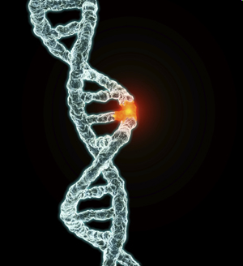
Alcohol-dependent Families
Genetic Influences
Effects of alcohol on the individual
Addictive tendency of the individual
Metabolism of alcohol in the body
Individual alcohol tolerance level
Notes:
The role that families have in the development of an addiction, specifically alcoholism, in an individual seems intuitive. Many factors related to family life have been shown to influence addictive behavior, including stress, observance of domestic violence between family members, experience of abuse by a parent, sibling or other relative, isolation, genetics, and the existence of alcoholism in the family. These factors might be specific and obvious or ill-defined and subtle. Often it is difficult to identify a problem and facilitate assistance for an individual because of denial among family members.
It is important to acknowledge and understand the role of certain factors that are unchangeable to fully appreciate the possible components at work in addiction development. One of these factors is genetics.
Effects of alcohol on individual
An individual’s genes can determine the possible effects of alcohol and the possibility of developing alcohol addiction. Genes can determine how an individual’s body metabolizes alcohol. The slower alcohol is metabolized, the more quickly the effects of the alcohol can be experienced and vice versa.
Addictive tendency of individual
Furthermore, genes can affect an individual’s alcohol tolerance, their ability to process the alcohol, and their risk of alcoholism or alcohol addiction.
Metabolization of alcohol in the body
Enzymes called alcohol dehydrogenase (ADH) and aldehyde dehydrogenase (ALDH) are found in the liver and help the alcohol eventually metabolize into carbon dioxide and water.
In people with certain genotypes, these enzymes are less active or less efficient; these gene variants can be more prevalent in certain populations (e.g., some Asian ethnicities). People with deficiencies of ADH and ALDH might be more susceptible to the effects of alcohol.
Alcohol tolerance
Genes linked with alcohol tolerance and dependence are typically inherited.
One study suggests that an estimated 5%–10% of females and 25% of males who have relatives who are alcoholics will develop alcohol dependence themselves. This study suggests that alcoholism can be passed down from generation to generation. It also suggests that (depending on an individual’s genes) males and females can experience the effects of alcohol differently.
It is important to note, however, that genetics are but one of the factors that can determine an individual’s risk of alcoholism. Many other factors contribute to the development of alcohol dependence.
(International Center for Alcohol Policies. (2001). Alcohol and “Special Populations”: Biological Vulnerability. ICAP Reports 10. Washington, DC: International Center for Alcohol Policies.)

Slide 31
Alcohol-dependent Families
Family Risk Factors
Parental use of alcohol associated with children’s use of alcohol
Adverse childhood experiences are associated with subsequent alcohol abuse
Lack of parental involvement in child’s life linked to subsequent alcohol abuse later in life
Notes:
Family factors that might contribute to alcohol use
Parent’s consumption of alcohol may be associated with a child’s initiation and continuation of alcohol consumption.
A study on heritability and alcoholism found that “early use of alcohol in mothers...was associated with a significant increase in both sons’ and daughters’ risk of alcohol use by age 14” (McGue, Iacano, Legrand, & Elkins, 2001, p. 1166). Maternal alcohol consumption and behavior can increase the risk of alcohol use by her children.
Alcoholism in a parent can cause negative social and emotional consequences that last into adulthood and can increase the risk of alcohol misuse (Table 3.9). Parental attitudes about drinking alcohol are also associated with whether a child will initiate and continue to drink. “Children who were warned [of the negative effects of] alcohol by their parents and children who reported being closer to their parents were less likely to start drinking” (NIAAA, 1997).
One study showed that higher levels of emotional abuse, parental alcoholism, constant parental conflict, and being made to feel unwanted or unloved can lead to alcohol addiction. The women in the study, who were recovering alcoholics, experienced more aversive childhood experiences than the general population (Harmer, Sanderson, & Mertin, 1999).
A parent’s or caregiver’s lack of involvement or negative involvement in a child’s life (especially in the formative years) can also lead to alcoholism. A lack of involvement can include lack of support, monitoring, and communication; negative involvement includes harsh, inconsistent discipline, and hostility or rejection. It is important to note that not only direct and obvious abuse, such as physical and sexual abuse, is included here. A child’s feeling neglected by his or her parent because of insufficient attention is also a risk factor for alcoholism).
Family atmosphere can affect the age at which an individual will initiate alcohol consumption. The earlier the initiation of alcohol use, the more likely that individual will develop an abusive relationship with alcohol (Kosterman, Hawkins, Guo, Catalano, & Abbott, 2000). In addition, teens whose families provide them with strong social support are less likely to use alcohol, according to one study (Mason & Windle, 2001).

Slide 32
In Closing….
Models of alcohol use
Categories of alcohol use
Stages of alcohol use in women
Stages of change in alcohol use
Coexisting disorders
Alcohol dependent families
Notes:
Review material presented in previous slides.

Slide 33


Arctic FASD Regional Training Center www.uaa.alaska.edu/arcticfasdrtc arcticfasdrtc@uaa.alaska.edu
907.786.6381
The Arctic FASD Regional Training Center is a project of the UAA Center for Behavioral Health Research & Services.
Funding for this project is provided by CDC Cooperative Agreement #U84DD000886-01.

